Slide 1


Slide 2
Mission
To make disciples who make other disciples, planting and nurturing churches that are:
Biblical
Nurturing
Relevant
Evangelistic

Slide 3
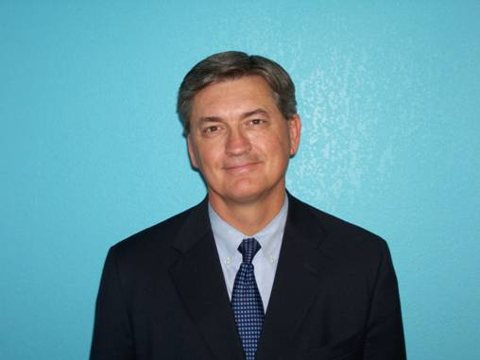
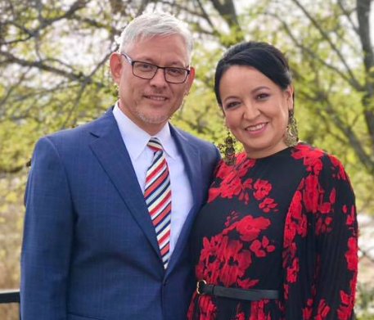
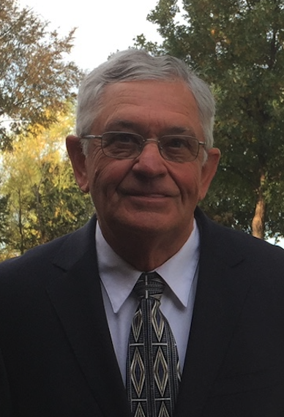
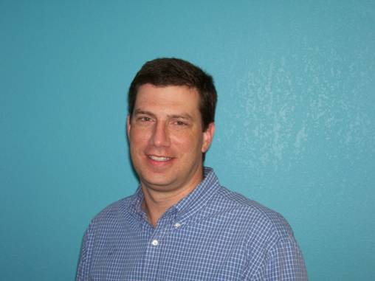
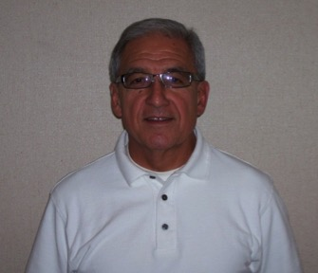
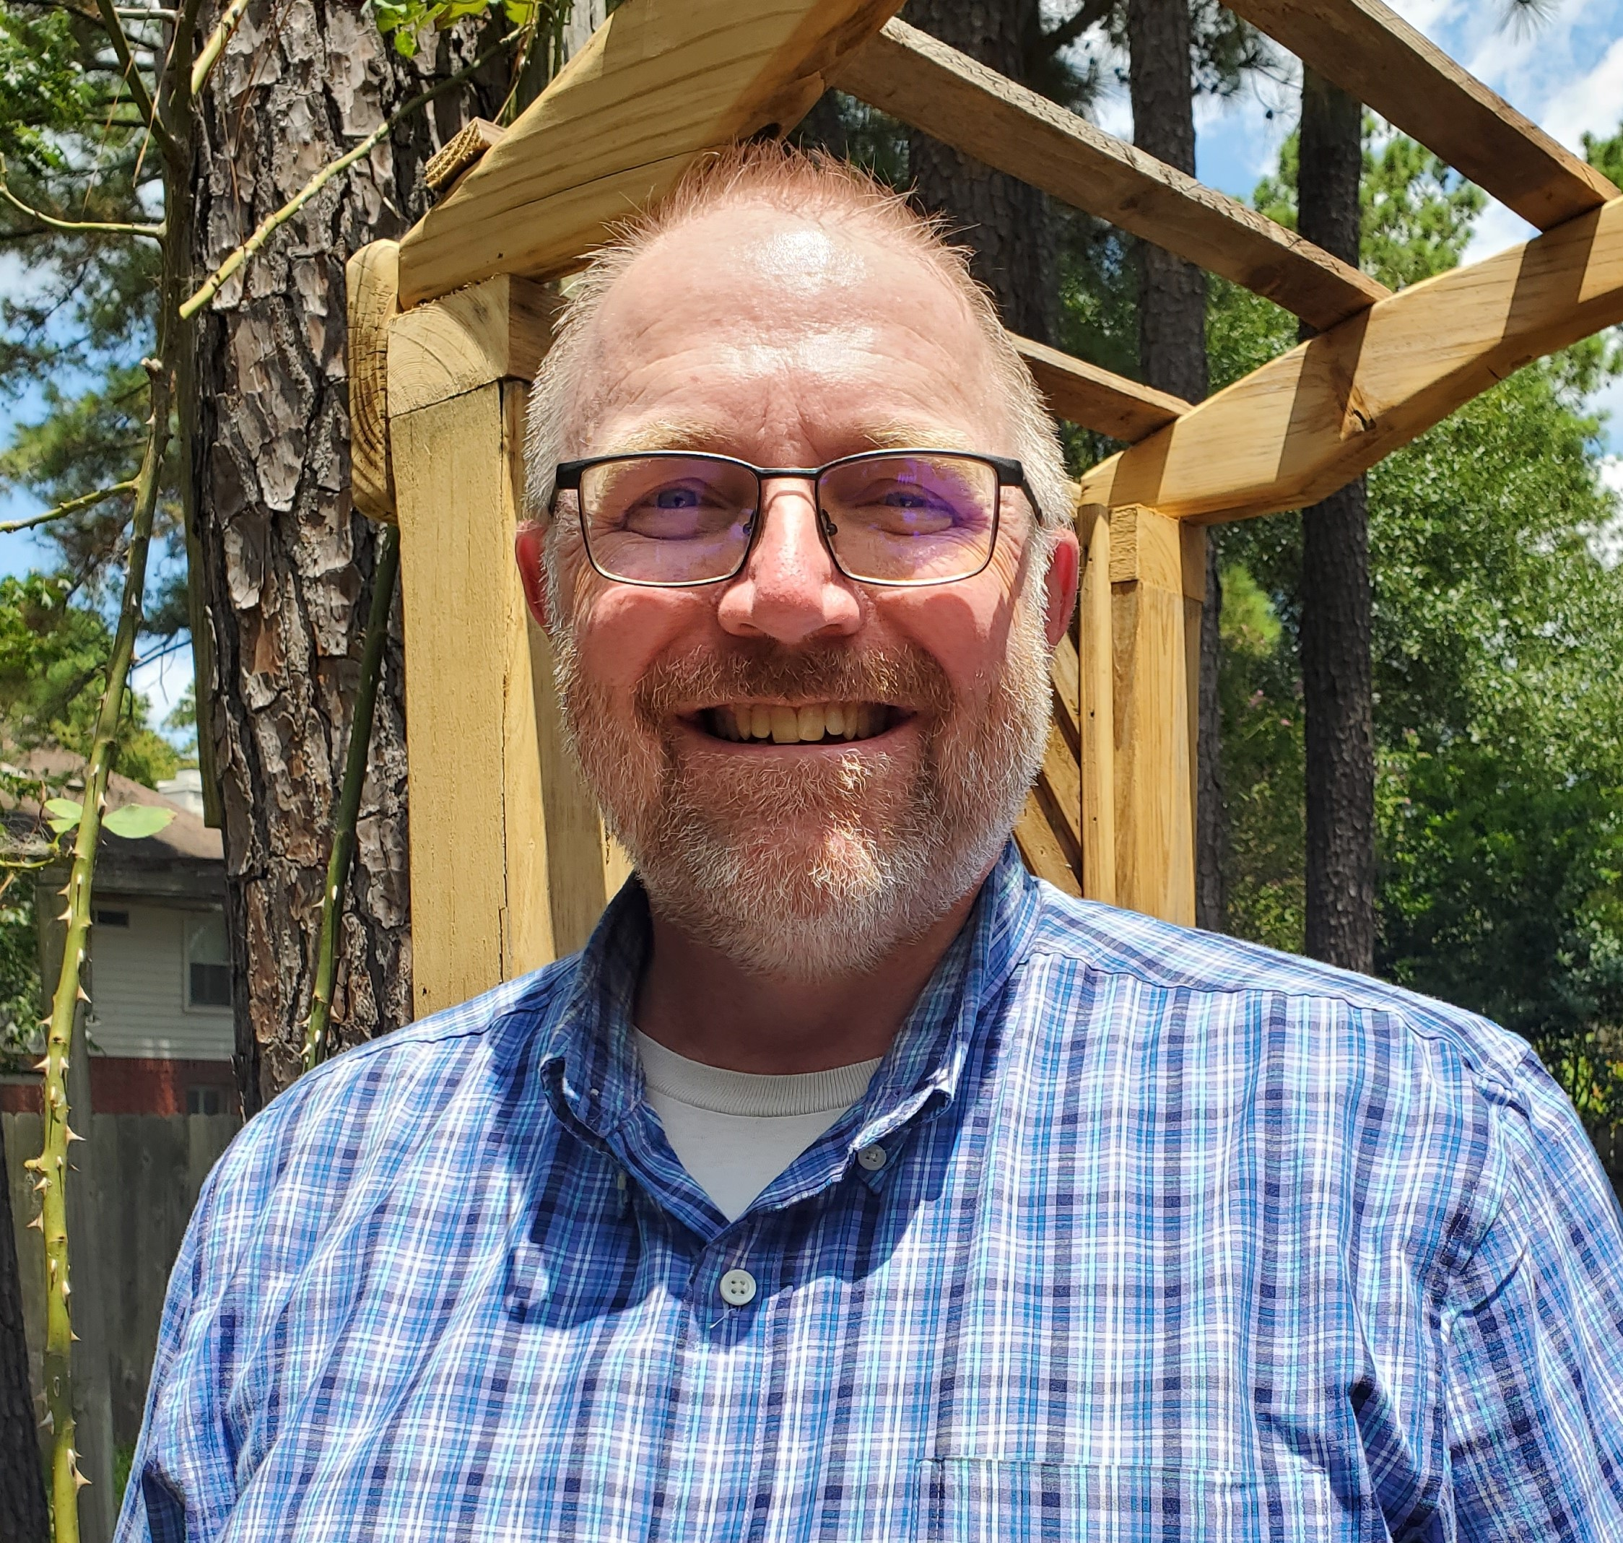
Board 2025
Randy King
Gustavo and Micaela Villanueva
Alan Mashburn
Lewis Norman
Flo Mata
Paul Gidden

Slide 4
TIBI’s values
Love
Respect
Open dialogue
Passion to search for truth together and learn
Unity in the heart of the gospel as found in I Cor, 15:1-4, Mat. 22:37-40, Matt. 23:23, Eph. 4:4-6, etc.

Slide 5
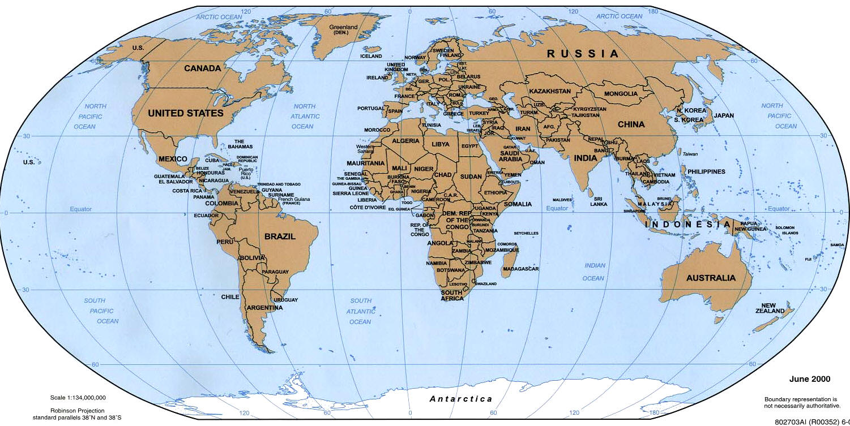
v
v
Valencia, Spain
v
v
v
v
v
v
v
v
v
v
v
v
v
v
v
v
v
v
v
v
v
Countries with video conferencing sites (yellow): 18
Students visited online from 76 countries total
(3100 current students, and more than 7000 in all since we began)

Slide 6
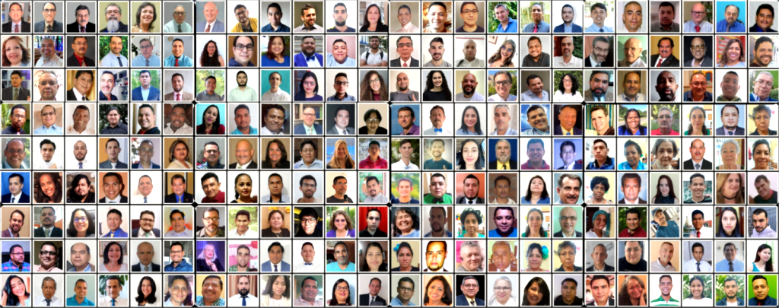
Part of TIBI’s alumni worldwide
v
v
v
v
v
v
v
v
v
v
v
v
v
v
v
v
v
v
v

Slide 7

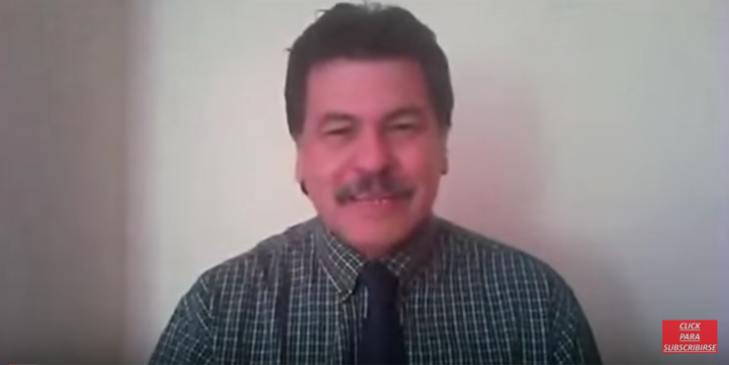
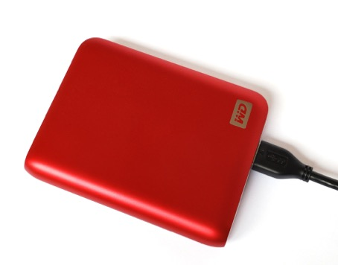
5600+ TIBI students worldwide!
100+ students in intensive,
interactive live video conferencing
classes
3100+ online students
2400+ EBL students (hard drive)

Slide 8
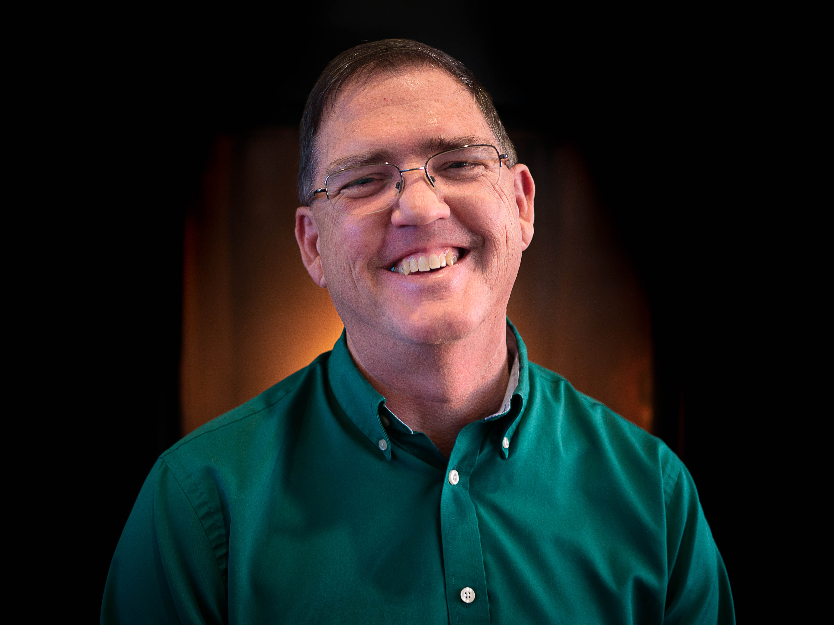
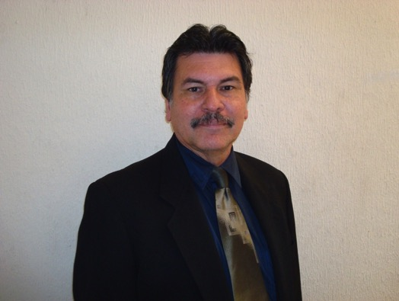
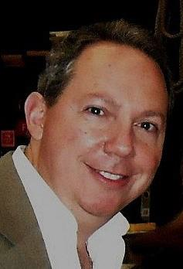
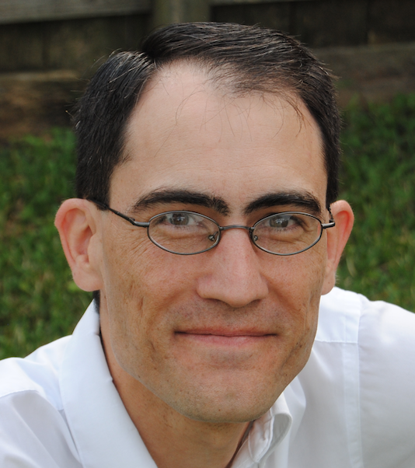
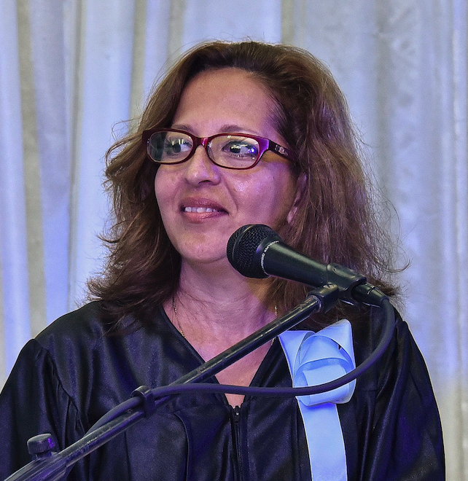
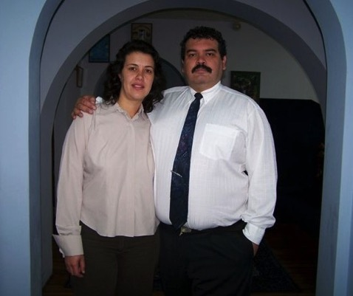
Admin team
Steve Austin
Director
Carlos Camacho
Field work supervisor
Daniel Urdaneta,
IT specialist
Kevin Montgomery
Assistant director
Liudmila Bencosme
TIBI coordinator--Cuba
Pedro and Silvia del Pozo
Online, EBL coordinators

Slide 9
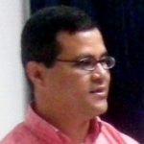
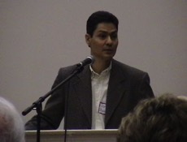

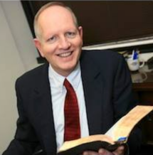

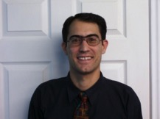
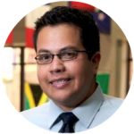
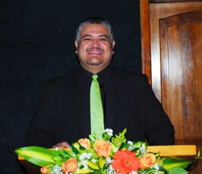
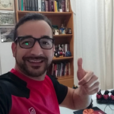
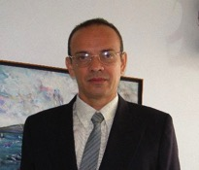
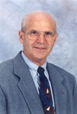
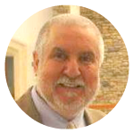
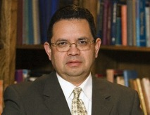

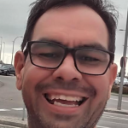


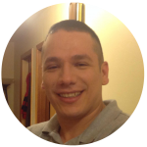



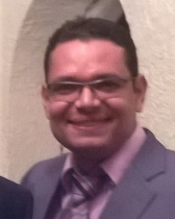
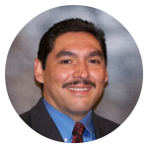
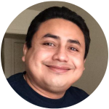



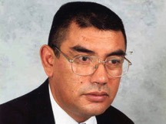
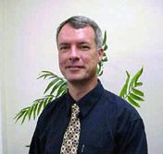
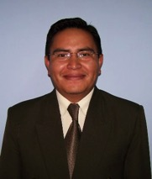
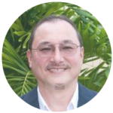
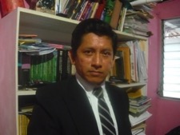
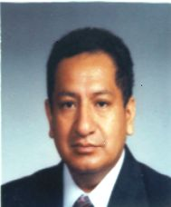
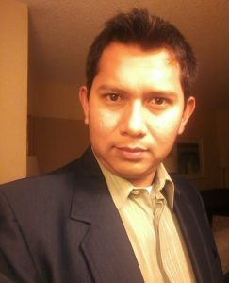
26 teachers, 9 countries!

Slide 10
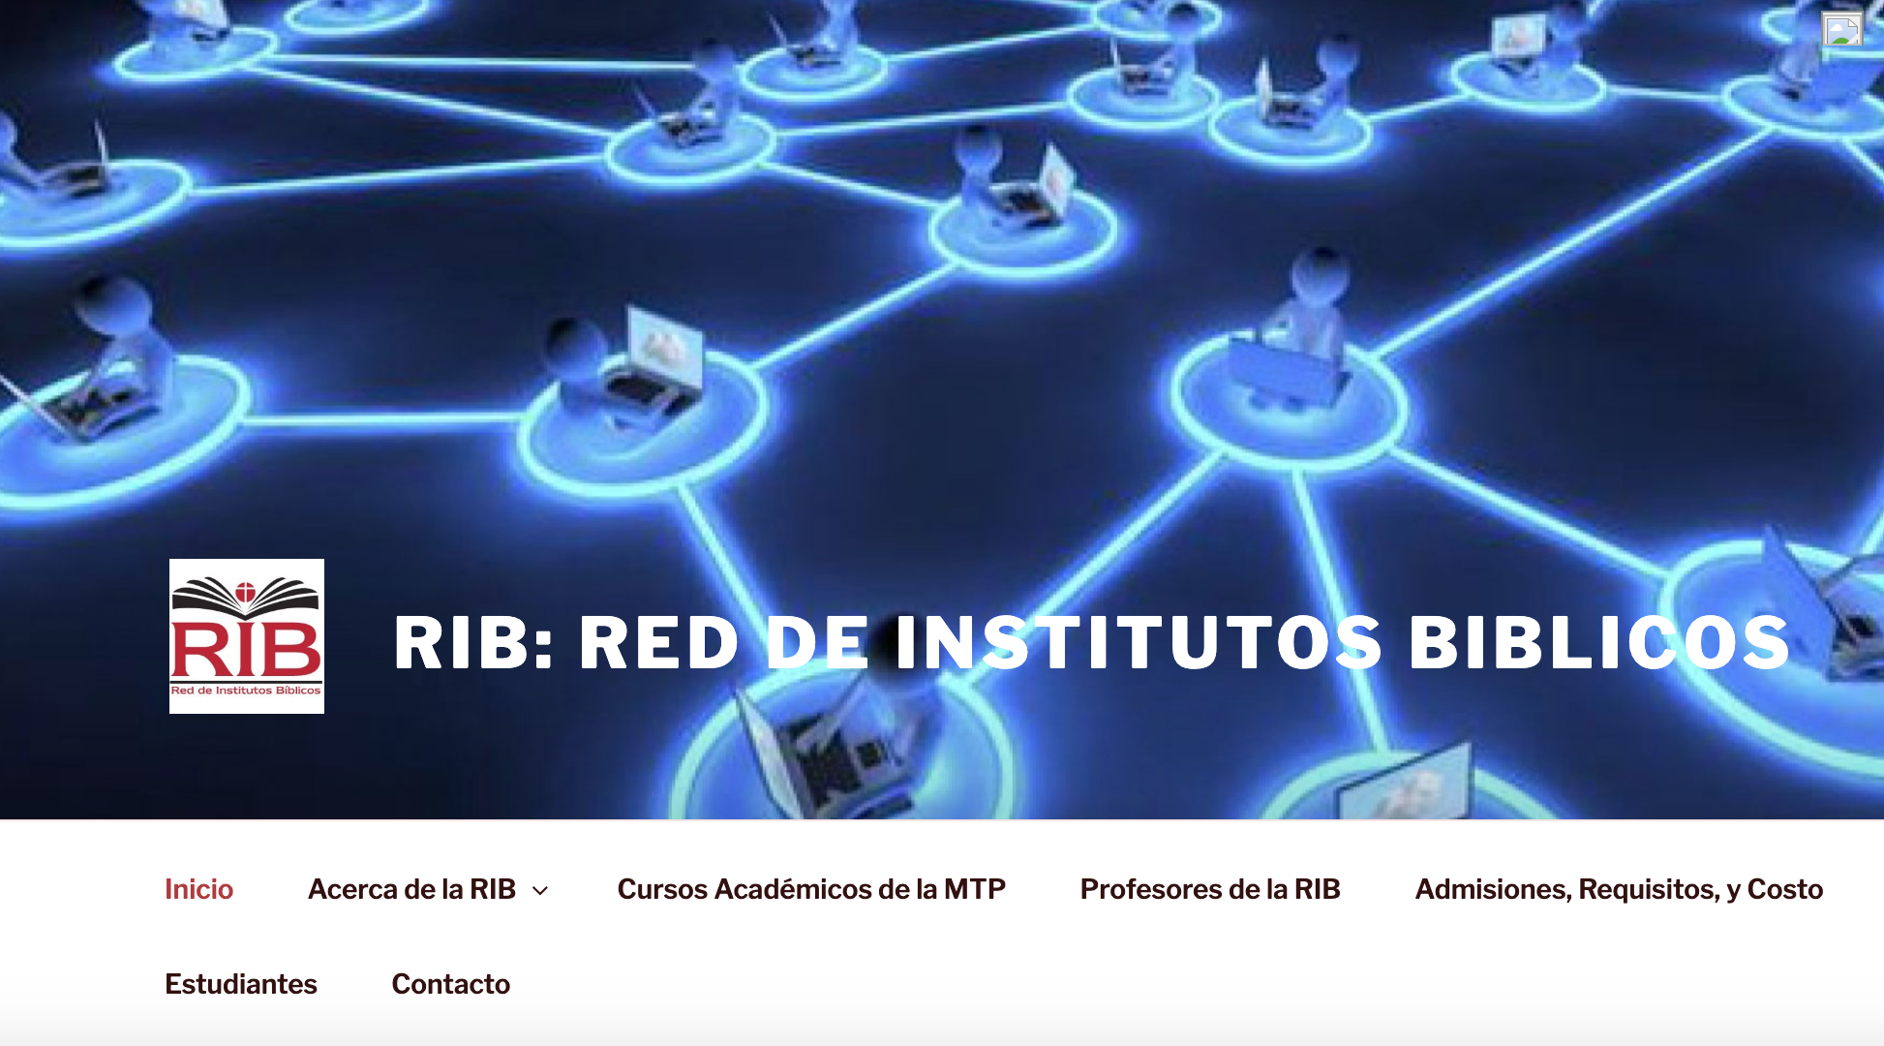
Masters of Practical Theology
‘TIBI collaborates with a group of schools (Red de Institutos Bíblicos) which is now offering a new Masters of Practical Theology—a 36-hour degree requiring 3 years of study.

Slide 11
46 students from three different cohorts are currently pursuing this degree. The eighth cohort with students started in August 2025.
We have graduated four cohorts so far, with a total of 49 students. 16 different countries are represented in these groups.
All professors of the master’s program have masters’ or doctoral degrees.
If you would like more information, go to the website at www.redinbi.org

Slide 12

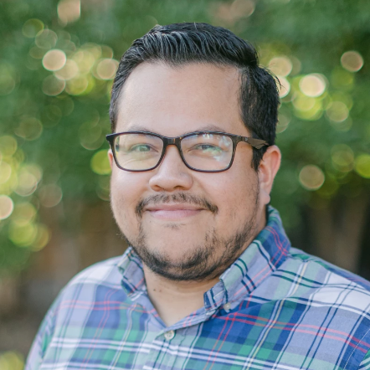
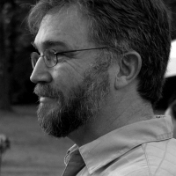
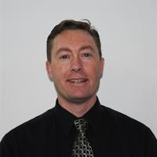
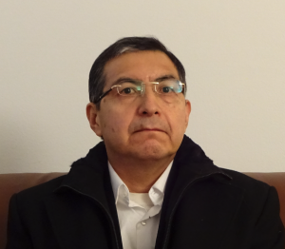
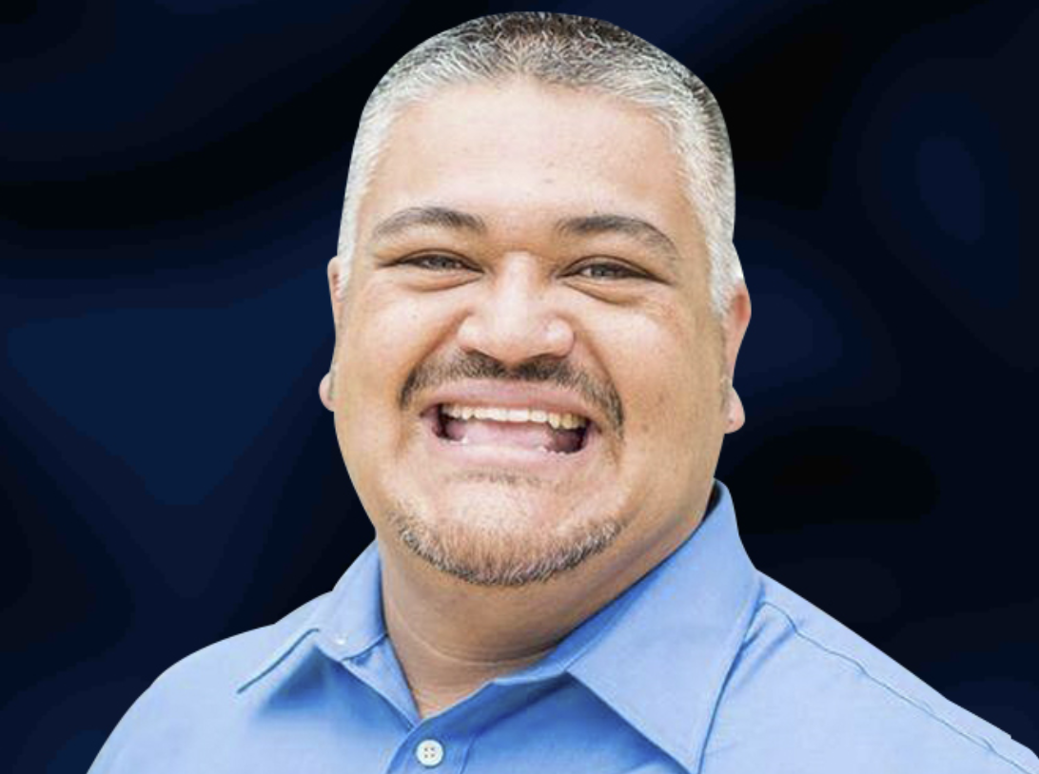
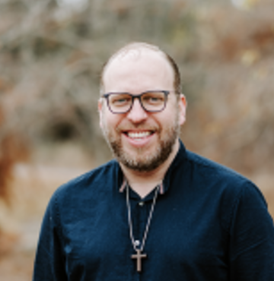
Faculty--Red de Institutos Bíblicos

Slide 13
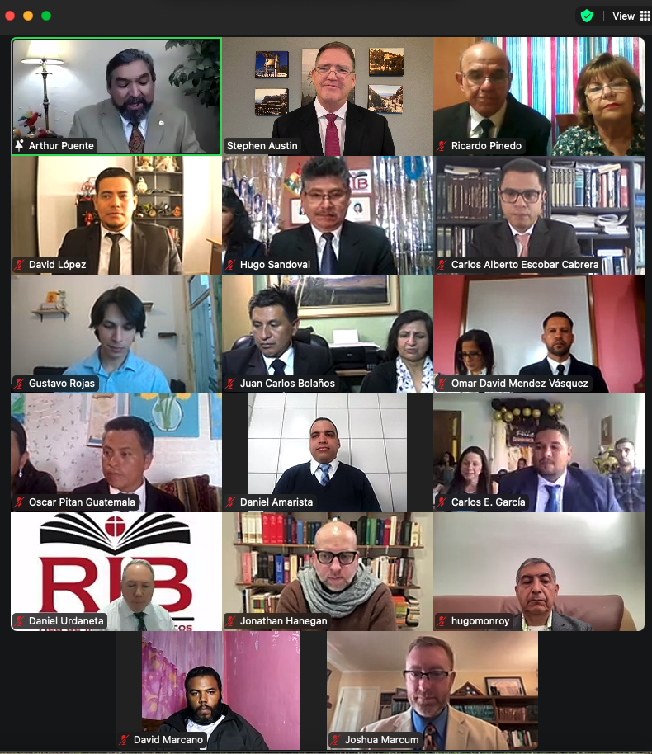
4th Graduation
August 10, 2024

Slide 14
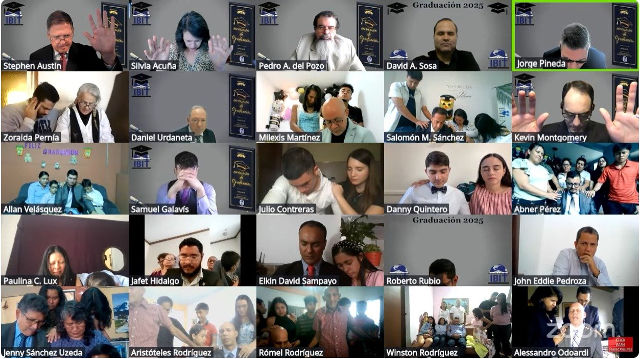
24th Graduation: July 19, 2025
Total graduates in 21 years: 244!
(Final prayer of blessing)

Slide 15

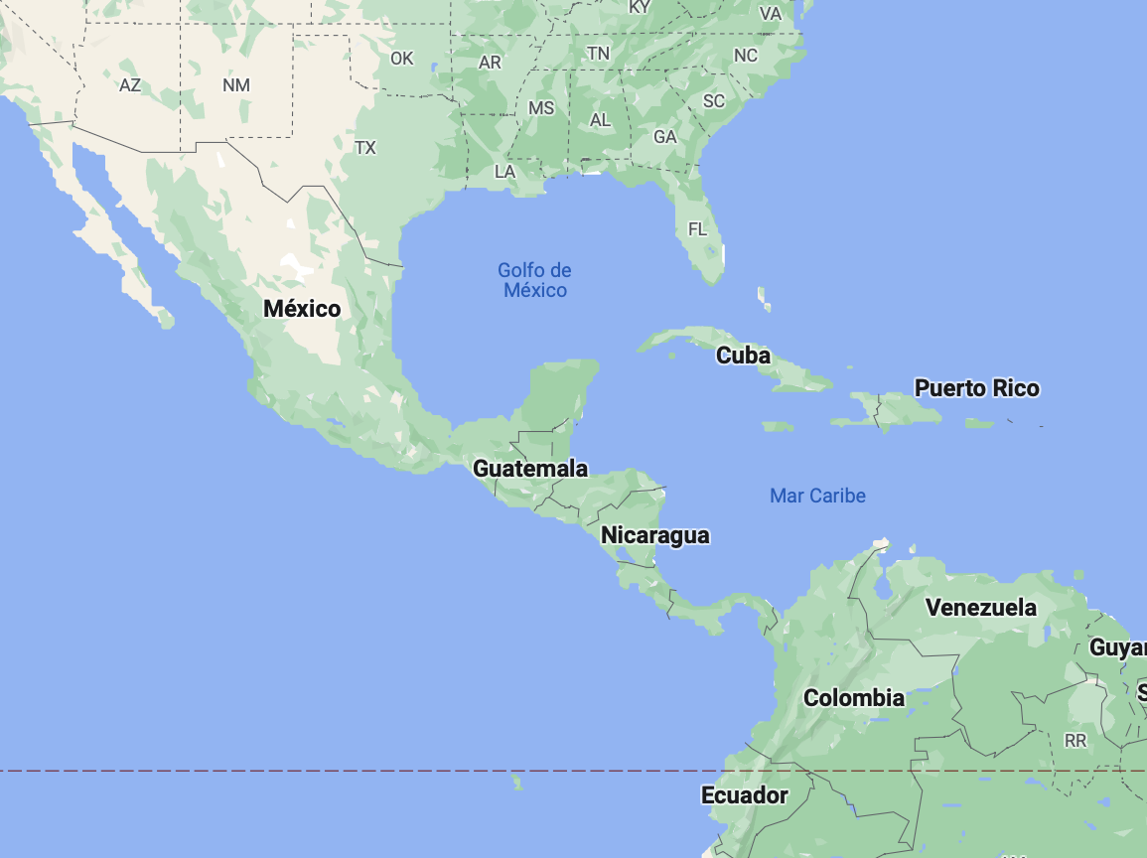

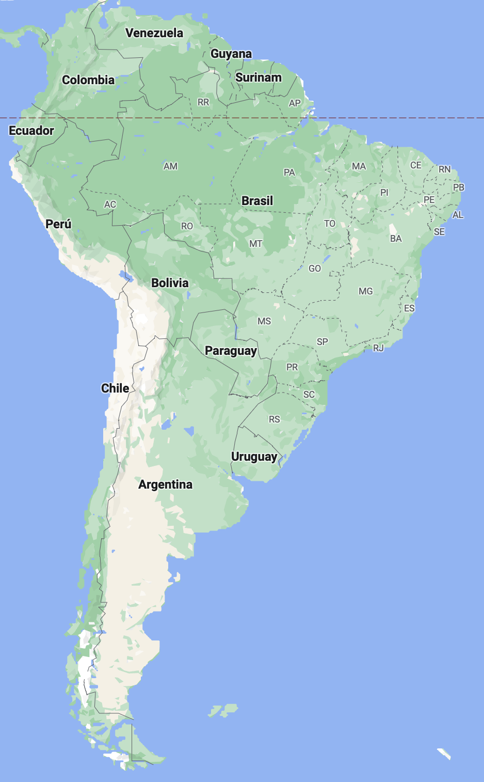













In all:
244

Slide 16



Hispanic Theological Education Association certifies our Bachelor of Ministry and Biblical Studies degree
October 2020
Jessica Lugo,
Director
Justo Gonzalez
Founder

Slide 17
AETH Certification
In 2020, after a process lasting almost two years, TIBI received word from the Asociación de Estudios Teológicos Hispanos (Association of Hispanic Theological Studies) that they have officially certified our Bachelors Degree, the Licenciatura en el Ministerio y Estudios Bíblicos (Bachelor of Ministry and Biblical Studies).
This certification is extended in collaboration with the Association of Theological School, the main accrediting agency of seminaries in the US.
This is a valuable external endorsement of our program which will allow our graduates to apply for graduate studies at any seminary in the US.
The class of 2022 was the first class to receive this new degree.

Slide 18


Growing Kingdom Impact Worldwide
We have at least 311 current full-time students or graduates working in 235 congregations in 167 cities in 20 countries (not counting any of our several thousand part-time students)
6100+ baptisms and 80 church plants worldwide since 2009!
(Plus those that weren’t reported!)
July 2025

Slide 19


  ACTIVITIES
  Minimum 10 hours/week, supervised, in church planting and ministry

Slide 20

Representatives of 35 church plants in Cuba

Slide 21

La Puerta—Agustin Garcia, minister
This church was planted after TIBI was founded, and in spring 2025 had its 19th anniversary

Slide 22

Matanzas, Cuba
Planted 50 congregations since 2006!

Slide 23

New congregation of El Salto, Mexico that opened in May 2022, helped by José Luis Martinez and Claudia Inglés, TIBI graduates

Slide 24
  VIDEO-
  CONFERENCING

Slide 25


Slide 26
Advantages
Up to 49 sites on the screen at once!
The TIBI system has capacity for 11,700 sites concurrently (300 sites in each of 39 classrooms)
Easy to connect and use
Accessible from any place in world with Internet (even a park in Cuba!)
Inexpensive, easily expandable, all virtual, continuously upgraded

Slide 27
Other options/advantages
Recording to the Cloud or personal computer
Ability to share whiteboard interactively
Ability to share any document and illustrate it
Ability to share videos
Ability to break out groups within classroom
Ability to stream live to Facebook or YouTube
Ability to offer simultaneous translations
Multiple methods of student feedback
Excellent administrative control and stats

Slide 28
What is needed for Zoom?
Computer with at least average processor speed and RAM
Webcam
Microphone (often included in webcam)
Connection to the internet with speeds at least 384k upload and 1 Mb download (the higher the better!)
Zoom software (free)
Small annual network access fee

Slide 29

Video library in the cloud

Slide 30
KINGDOM ACTIVITIES
With video conferencing

Slide 31

Normal live interactive classes (students, churches)
60+ courses offered in 2023-24 school year
25 hours per week
Various Saturday seminars

Slide 32
Other current, past, or future activities
One-day seminars or retreats
Masters’ level courses
Ongoing mentoring by other missionaries, elders, ministers, or professionals
Mission team training
Individual or marriage counseling
Classes for refugees
Marriage ceremonies or baptisms!

Slide 33
  ONLINE
  PROGRAM

Slide 34

www.ibitenlinea.org
In preparation
Anthropology 2
Church history 1 and 2
Praise and worship 2025
Faith and human development
Spiritual formation 2025
Available now—42 courses
Old Testament New Testament Tools Ministry
OT 1, 2, 3, 4 Life of Christ 1, 2 Hebrew 1 , 2 Spiritual Formation
Wisdom literature Acts Greek 1, 2 Christian Home
Isaiah Romans/Galatians Hermen./Exeg. 1, 2 Counseling
Jeremiah/Lamentations 1-2 Corinthians Homiletics 2024 Leadership
Ezekiel/Daniel Prison epistles Analytical thinking Christianity/Culture
Minor prophets Pastorals Intro to Ministry
1-2 Peter, James History Small groups
Hebrews History/Geography Religious groups
Revelation Church History 1 Church planting
Restoration History Worship
Heaven
Anthropology 1

Slide 35
Online video courses
With 42 courses recorded, one can now study online and receive the Bachelor of Biblical Studies diploma.
3100+ students in 76 countries—including 20 of the 21 Spanish speaking countries as well as other nations like Russia, Sweden, Finland, Algeria, Zambia, and Angola!

Slide 36

Benefits
Requires only an internet connection
Classes are available 24 hours a day
Can take the courses for free

Slide 37

Hard Drives for Remote Schools
For remote locations where there is limited to no access to the internet, we put all our course materials on hard drives
Facilitated and graded by local workers
We have had 55 EBLs in 17 countries, with a total of 59 coordinators and 935 students since we began.
Additionally, in Cuba TIBI
has more than 18,000 students
who have used this format.

Slide 38
  TIBI on YouTube
  https://www.youtube.com/c/InstitutoBiblicoInternacionaldeTexasIBIT
  Or
  search “IBIT Instituto”
  on the YouTube page

Slide 39

TIBI Playlist page

Slide 40
SINCE APRIL 2015 ON YOUTUBE…
1300+ videos uploaded
1,485,000+ views
More than 10.4 million minutes viewed
14,300+ subscribers
Easier access for some in Internet-limited places

Slide 41

TIBI website
(ibitibi.org)

Slide 42
FABULOUS STORIES OF HOW GOD WORKS…
In gang neighborhoods through Isaac Torres in Venezuela
In national crises in Colombia and Nicaragua
In Cuba through Tony and Liudmila Fernandez, or prison jails through Felix
Who knows what else God has in store?

Slide 43
With God’s power and creativity, we are like:
Gideon, whose weakness God changed to strength.
Esther, whom God used in the right place at the right time.
Mustard plants, which grow large from a tiny seed.

Slide 44
How can you help?
Encouragement and prayer.
Come visit! And tell others…
Recommend students
Contribute to a student scholarship ($100-700/month)
Buy hard drive for remote sites ($70)

Slide 45
Ways to Donate
Download the Zelle app on your phone or tablet, and send money to montgomery.texasbible@gmail.com
Online bill pay with your bank (can set it up to be recurring)
Paypal: Go to http://ibitibi.org/en/donations, click on Donate, and put in our info (can be recurring)
Normal checks
Even estate gifts or IRA disbursements.

Slide 46
TIBI Information and Resources
School Website: www.ibitibi.org
Masters program: www.redinbi.org
Online video courses: ibitenlinea.org
YouTube (courses and Israel videos) https://www.youtube.com/c/InstitutoBiblicoInternacionaldeTexasIBIT
Facebook https://www.facebook.com/IBIT-y-Sunsetonline-111879462197567/?fref=ts

Slide 47

Texas International Bible Institute
STEPHEN AUSTIN
Austin@ibitibi.org
KEVIN MONTGOMERY
Montgomery@ibitibi.org
1502 Avenue I
Or P.O. Box 1501
South Houston, Texas, 77587
(713) 910-2819

