Slide 1


Slide 2
Beginnings of TIBI
Need for more Hispanic churches, models, and workers
To go or not to go
God can do more than you ask or imagine

Slide 3
Mission
To make disciples who make other disciples, planting and nurturing churches that are:
Biblical
Nurturing
Relevant
Evangelistic

Slide 4
TIBI’s values
Loving, open, respectful dialogue, focused on unity in the gospel of Jesus (I Cor, 15:1-4, Mat. 22:37-40, Matt. 23:23, Eph. 4:4-6
Train in place
Provide lifelong support network

Slide 5
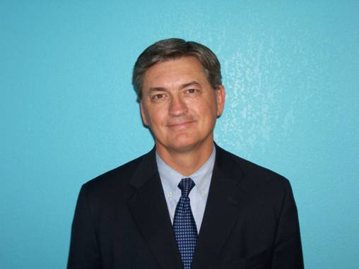
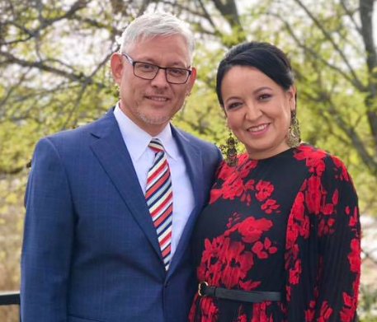
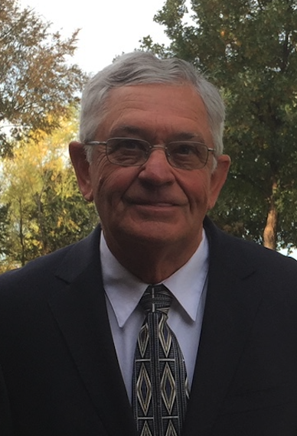
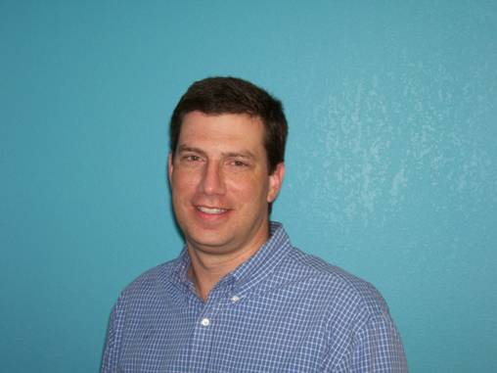
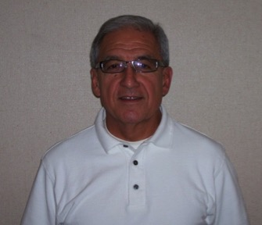
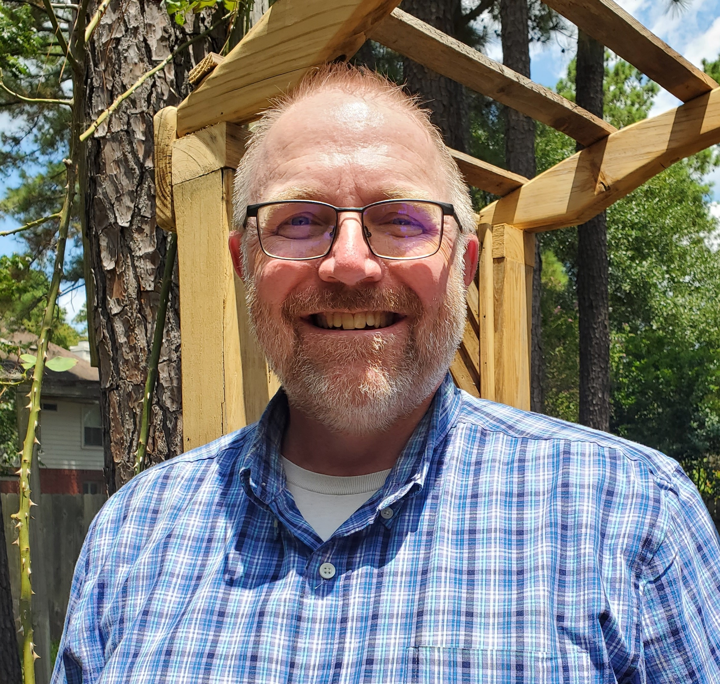
Board 2026
Randy King
Gustavo and Micaela Villanueva
Alan Mashburn
Lewis Norman
Flo Mata
Paul Gidden

Slide 6
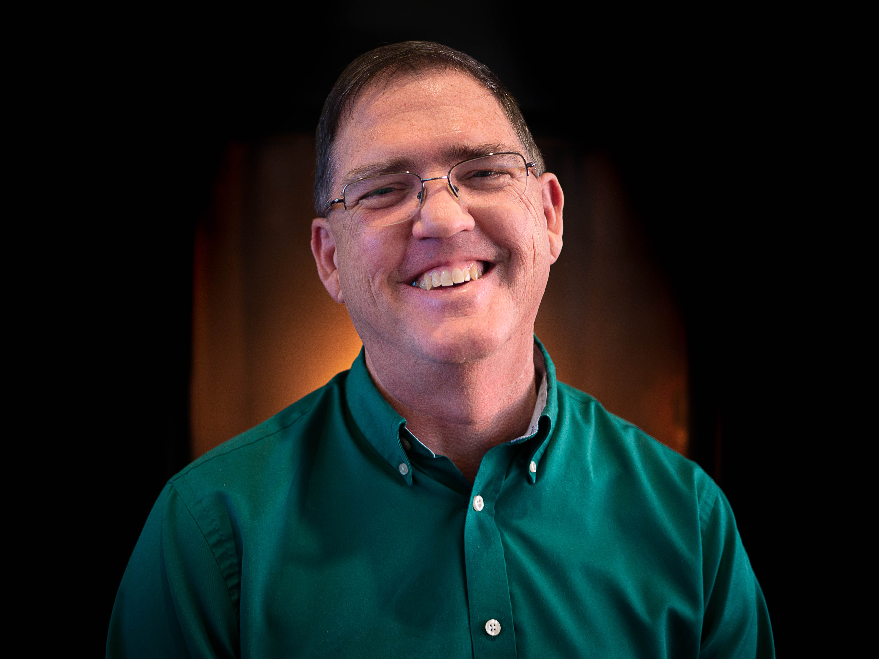
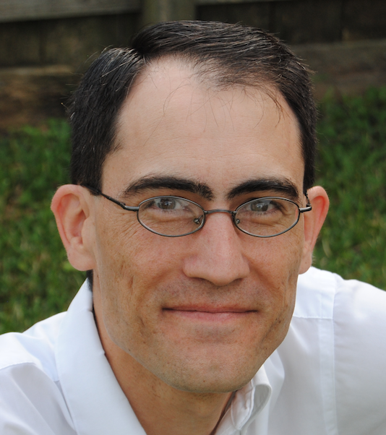
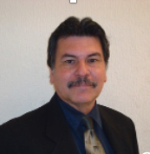
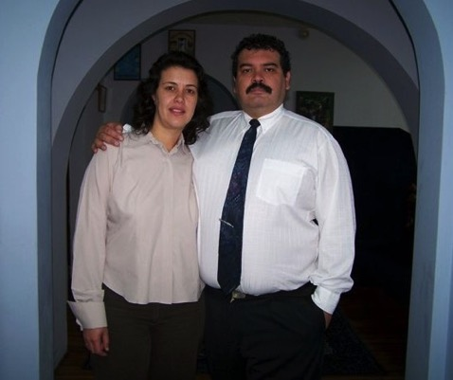
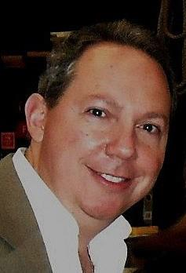
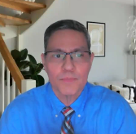
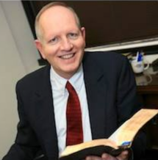
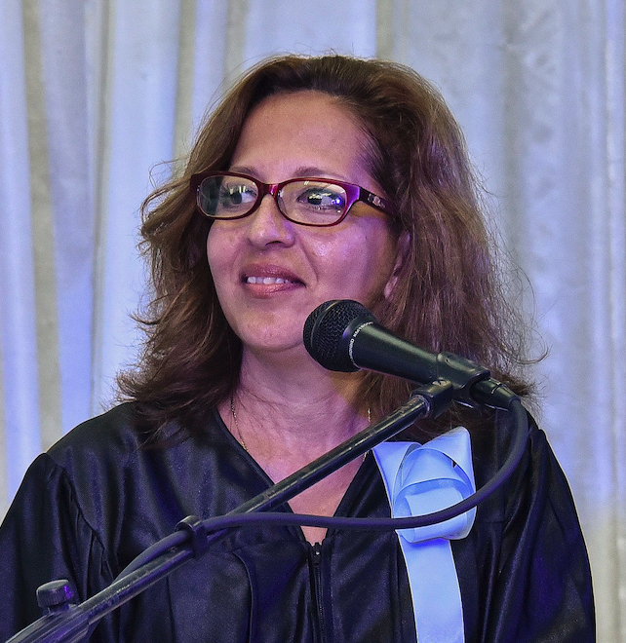
Admin team 2026
Steve Austin
Director
Kevin Montgomery
Assistant director
Carlos Camacho
Field work supervisor
Pedro and Silvia del Pozo
Online, EBL coordinators
Daniel Urdaneta,
IT specialist
Tim Archer,
Development
Liudmila Bencosme
TIBI coordinator--Cuba
Jorge Pineda,
Accelerated Ministy
Program

Slide 7
Degrees and certificates
Bachelors of Ministry and biblical studies: 42 courses (2 years full-time)
Certificate of ministry: 12 courses
Certificate of Christian worker: 16 courses
Certificate of biblical studies: 23 courses
Our Bachelors is certified by the Hispanic Theological Education Association (AETH), in collaboration with the Association of Theological Schools, the main accrediting agency of seminaries in the US.
This is a valuable external endorsement of our program which will allow our graduates to apply for graduate studies at any seminary in the US.

Slide 8
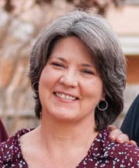

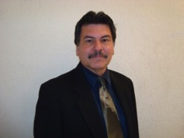
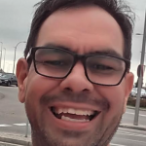
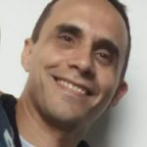
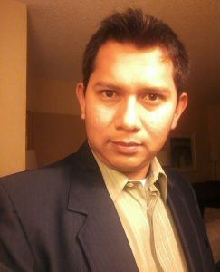
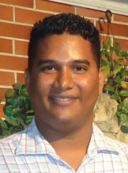
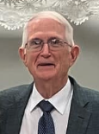
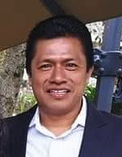
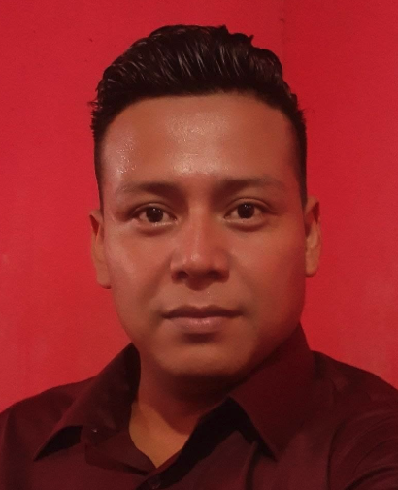
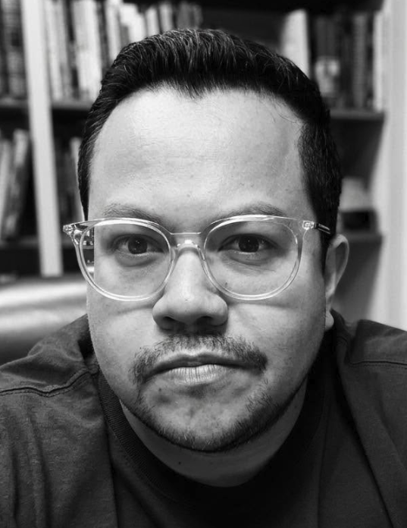
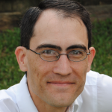
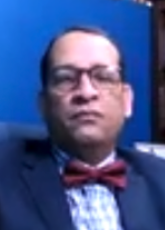
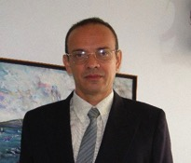
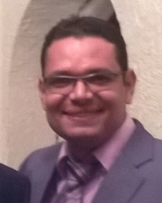
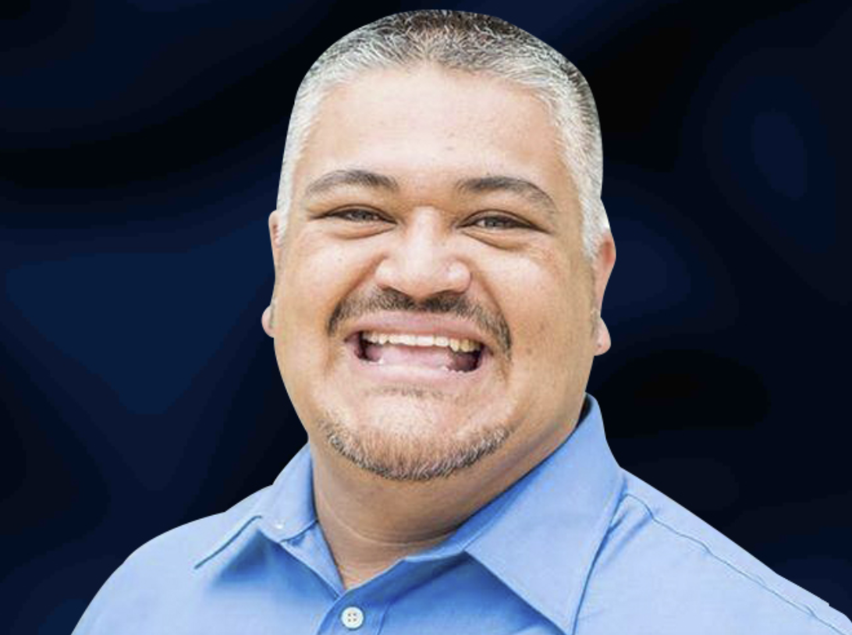
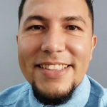
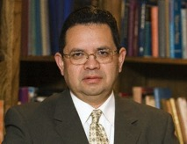
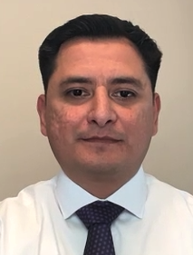
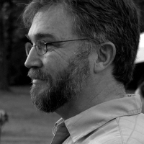
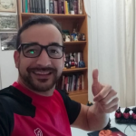
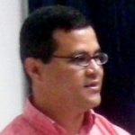
24 teachers, 8 countries! (Zoom courses)
Steve Austin
Carlos Camacho
Leonardo
Capodicasa
Tim Archer
Carolina Archer
Rolando Camacho
Reynaldo Dominguez
Carlos Garcia
Glen Henton
Benjamin Matul
Alejandro Mena
Juan Meza
Kevin Montgomery
Daniel Nin
Alirio Ortega
César Paez
Omar Palafox
Wladimir Pereira
Jorge Pineda
Sixto Rivera
Alfonso Sanchez
Yancy Smith
Isaac Torres
Bernie Villalobos

Slide 9
Masters of Practical Theology
TIBI collaborates with other schools which offers this 36-hour, 3-year degree
44 students from three different cohorts are currently pursuing this degree. The ninth cohort with students starts in August 2026.
As of July 2026, have graduated 60 students.
17 different countries are represented in these groups.
All professors of the master’s program have masters’ or doctoral degrees.

Slide 10
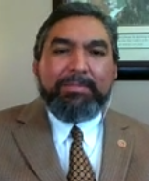

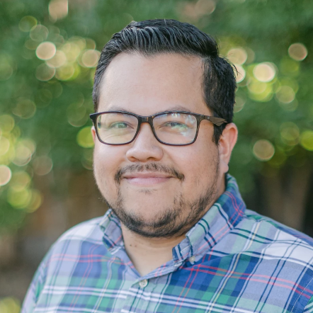
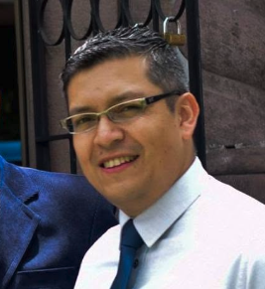
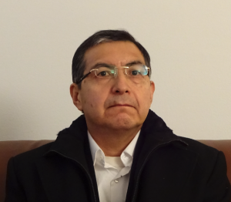
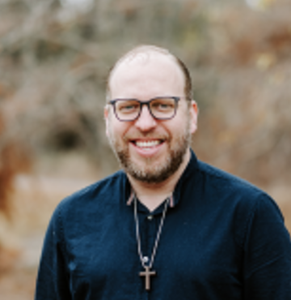
Faculty--Red de Institutos Bíblicos
Arthur Puente
James Henderson
Juan Meza
Yancy Smith
Jhon Cuarán
Tim Archer
Benjamin Matul
Hugo Monroy
Omar Palafox
Steve Austin
Jonathan Hanegan

Slide 11

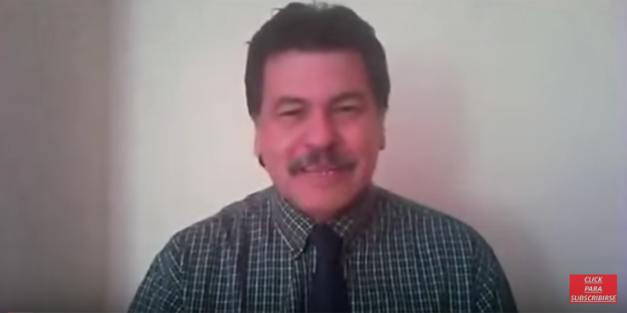
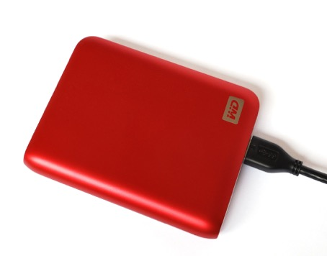
4600+ TIBI students worldwide!
100+ students in intensive,
interactive live video conferencing
classes
2100+ online students
2150+ Cuba students (18034+ since 2012)
250 students in other local Bible schools

Slide 12
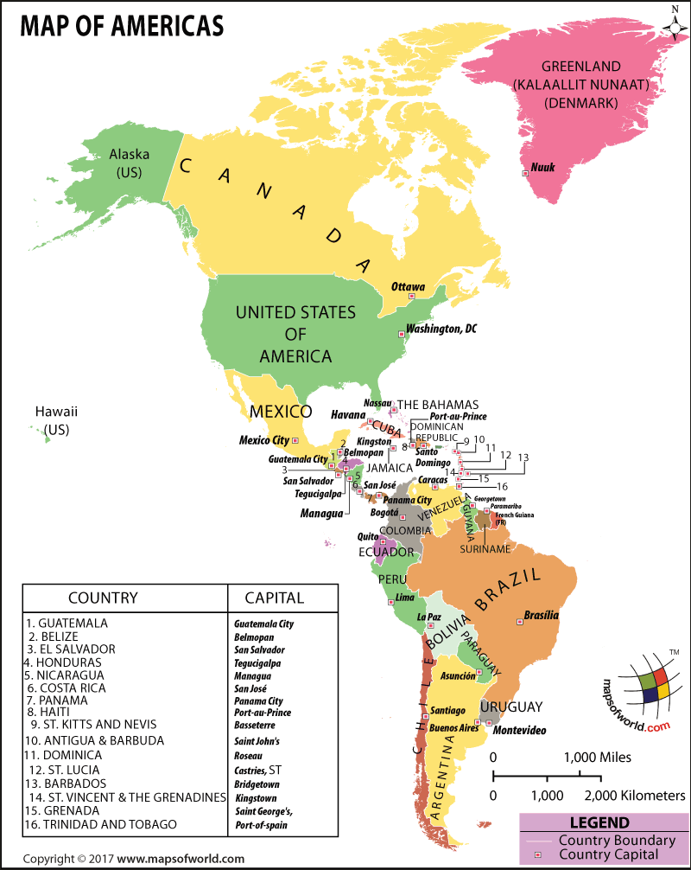

Countries with video conferencing sites
(red star): 20
www.ibitenlinea.org
2100 students online from 181 countries and 44 territories total
Only 11 countries in the world where we don’t have students
This only counts active students of the last 2 years.
11000+ in all since we began
3 million+ visits
Spain

Slide 13
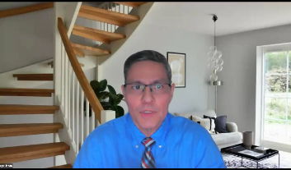
TIBI online (2100 students)
www.ibitenlinea.org
Preparing:
Spiritual formation 2026
And updating several more
Available now—44 courses
Old Testament New Testament Tools Ministry
OT 1, 2, 3, 4 Life of Christ 1, 2 Hebrew 1, 2 Spiritual Formation
Wisdom literature Acts Greek 1, 2 Christian Home
Isaiah Romans/Galatians Hermen./Exeg. 1, 2 Counseling
Jeremiah/Lamentations 1-2 Corinthians Homiletics Leadership
Ezekiel/Daniel Prison epistles Analytical thinking Christianity/Culture
Minor prophets Pastorals Intro to Ministry
1-2 Peter, James History Small groups
Hebrews History/Geography Religious groups
Revelation Church History 1, 2 Church planting
Restoration History Worship and music
Heaven
Anthropology 1
Faith and Human development

Slide 14

Hard Drives for Remote Schools
For remote locations where there is limited to no access to the internet, we put all our course materials on hard drives
Facilitated and graded by local workers
We have had 55 EBLs in 17 countries, with a total of 59 coordinators and 935 students since we began.
Additionally, in Cuba TIBI
has more than 18,000 students
who have used this format.

Slide 15
whatsapp courses
Students receive class audios and pdfs through WhatsApp chat.
Professors meet with students for an hour to review material and answer questions every 1-2 weeks. (more interaction than online, less than Zoom.)
Especially useful for places with very low bandwidth or little internet.

Slide 16
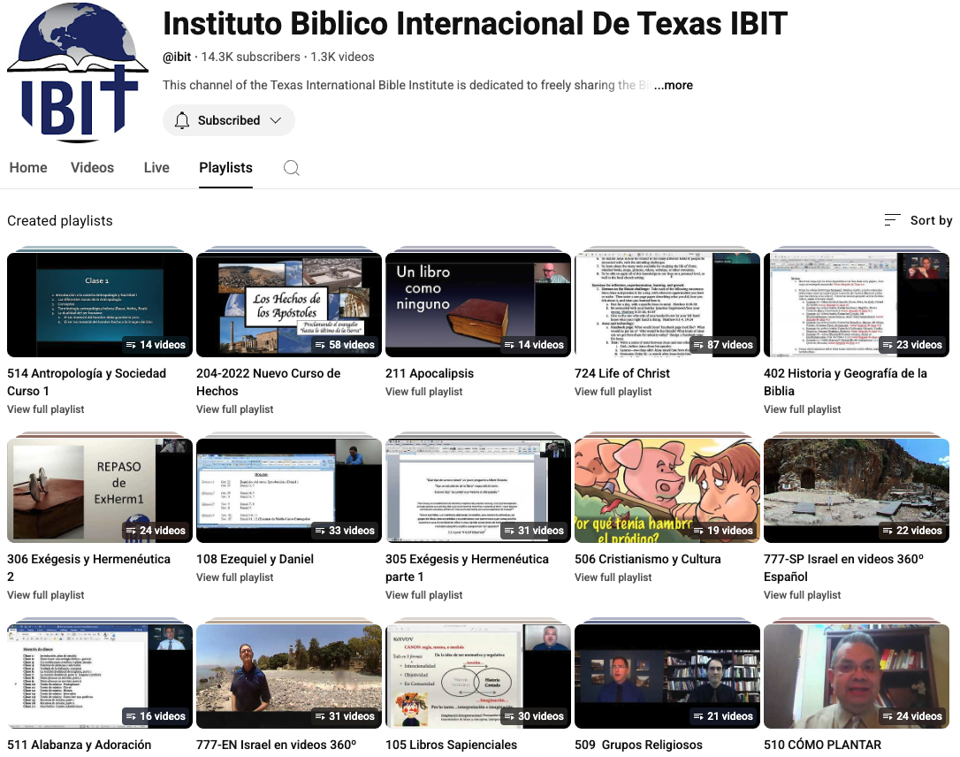
  https://www.youtube.com/c/InstitutoBiblicoInternacionaldeTexasIBIT

Slide 17
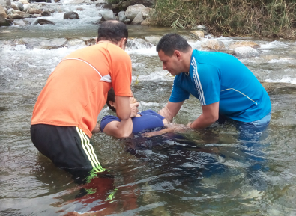
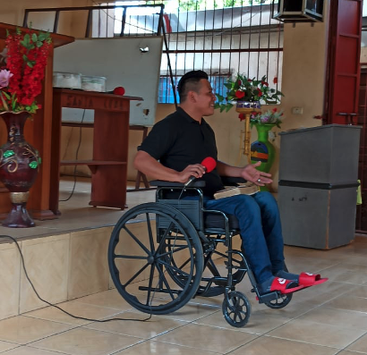
Growing Kingdom Impact Worldwide
We have at least 363 current full-time students or graduates working in 235 congregations in 179 cities in 21 countries (not counting any of our several thousand part-time students)
6500+ baptisms and 81 church plants worldwide since 2009!
(Plus those that weren’t reported!)
June 2026

Slide 18
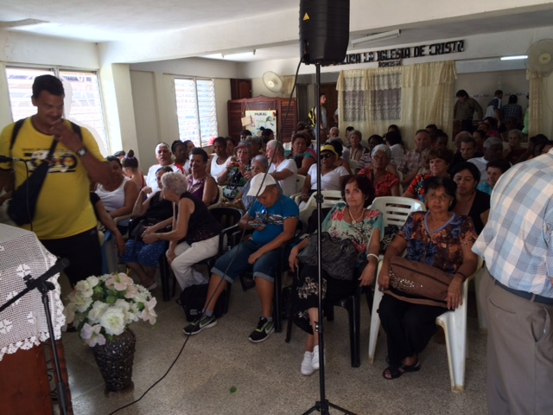
Representatives of 35 church plants in Cuba

Slide 19
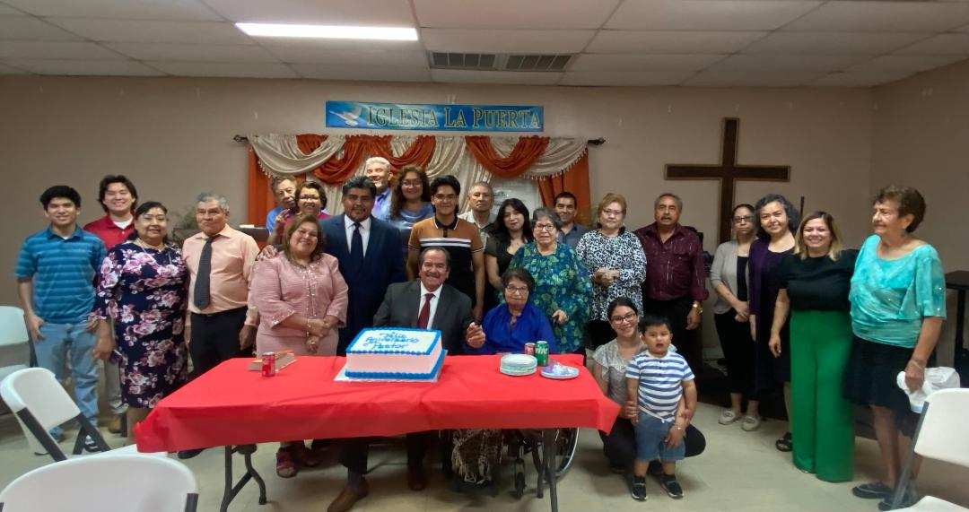
La Puerta—Agustin Garcia, minister
This church was planted after TIBI was founded, and in spring 2026 had its 20th anniversary

Slide 20
FABULOUS STORIES OF HOW GOD WORKS…
In gang neighborhoods through Isaac Torres in Venezuela
In Cuba in prison jails through Felix
In Nashville—TIBI grads started or work in two Hispanic works in Nashville
Who knows what else God has in store?

Slide 21
How can you help?
Encouragement and prayer.
Visit us online or during a class!
Recommend interested students or churches
Contribute to a student scholarship ($400-800/month)
Buy hard drive for remote sites ($100)
Technology
Professors

Slide 22
TIBI Information and Resources
School Website: www.ibitibi.org
Masters program: www.redinbi.org
Online video courses: ibitenlinea.org
YouTube (courses and Israel videos) https://www.youtube.com/c/InstitutoBiblicoInternacionaldeTexasIBIT
Facebook https://www.facebook.com/IBIT-y-Sunsetonline-111879462197567/?fref=ts

