Slide 2
Mission
To make disciples who make other disciples, planting and nurturing churches that are:
Biblical
Nurturing
Relevant
Evangelistic

Slide 3
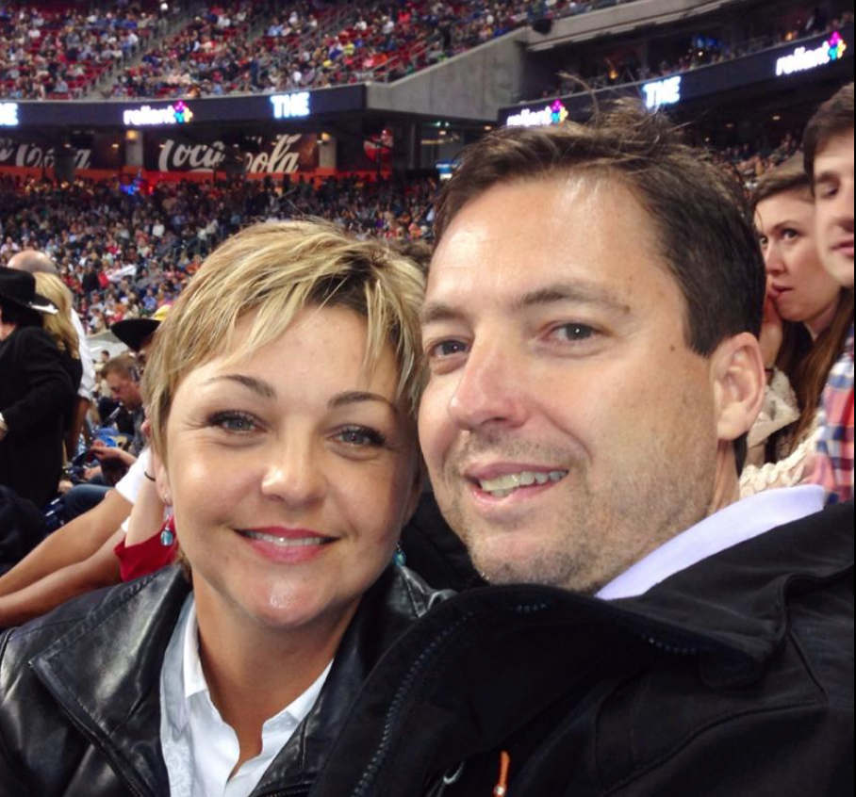
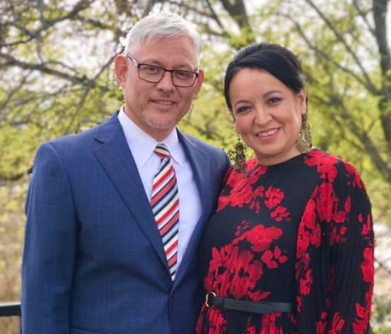
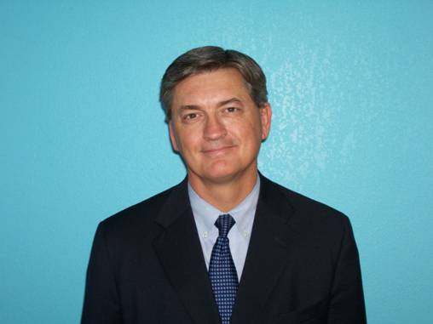
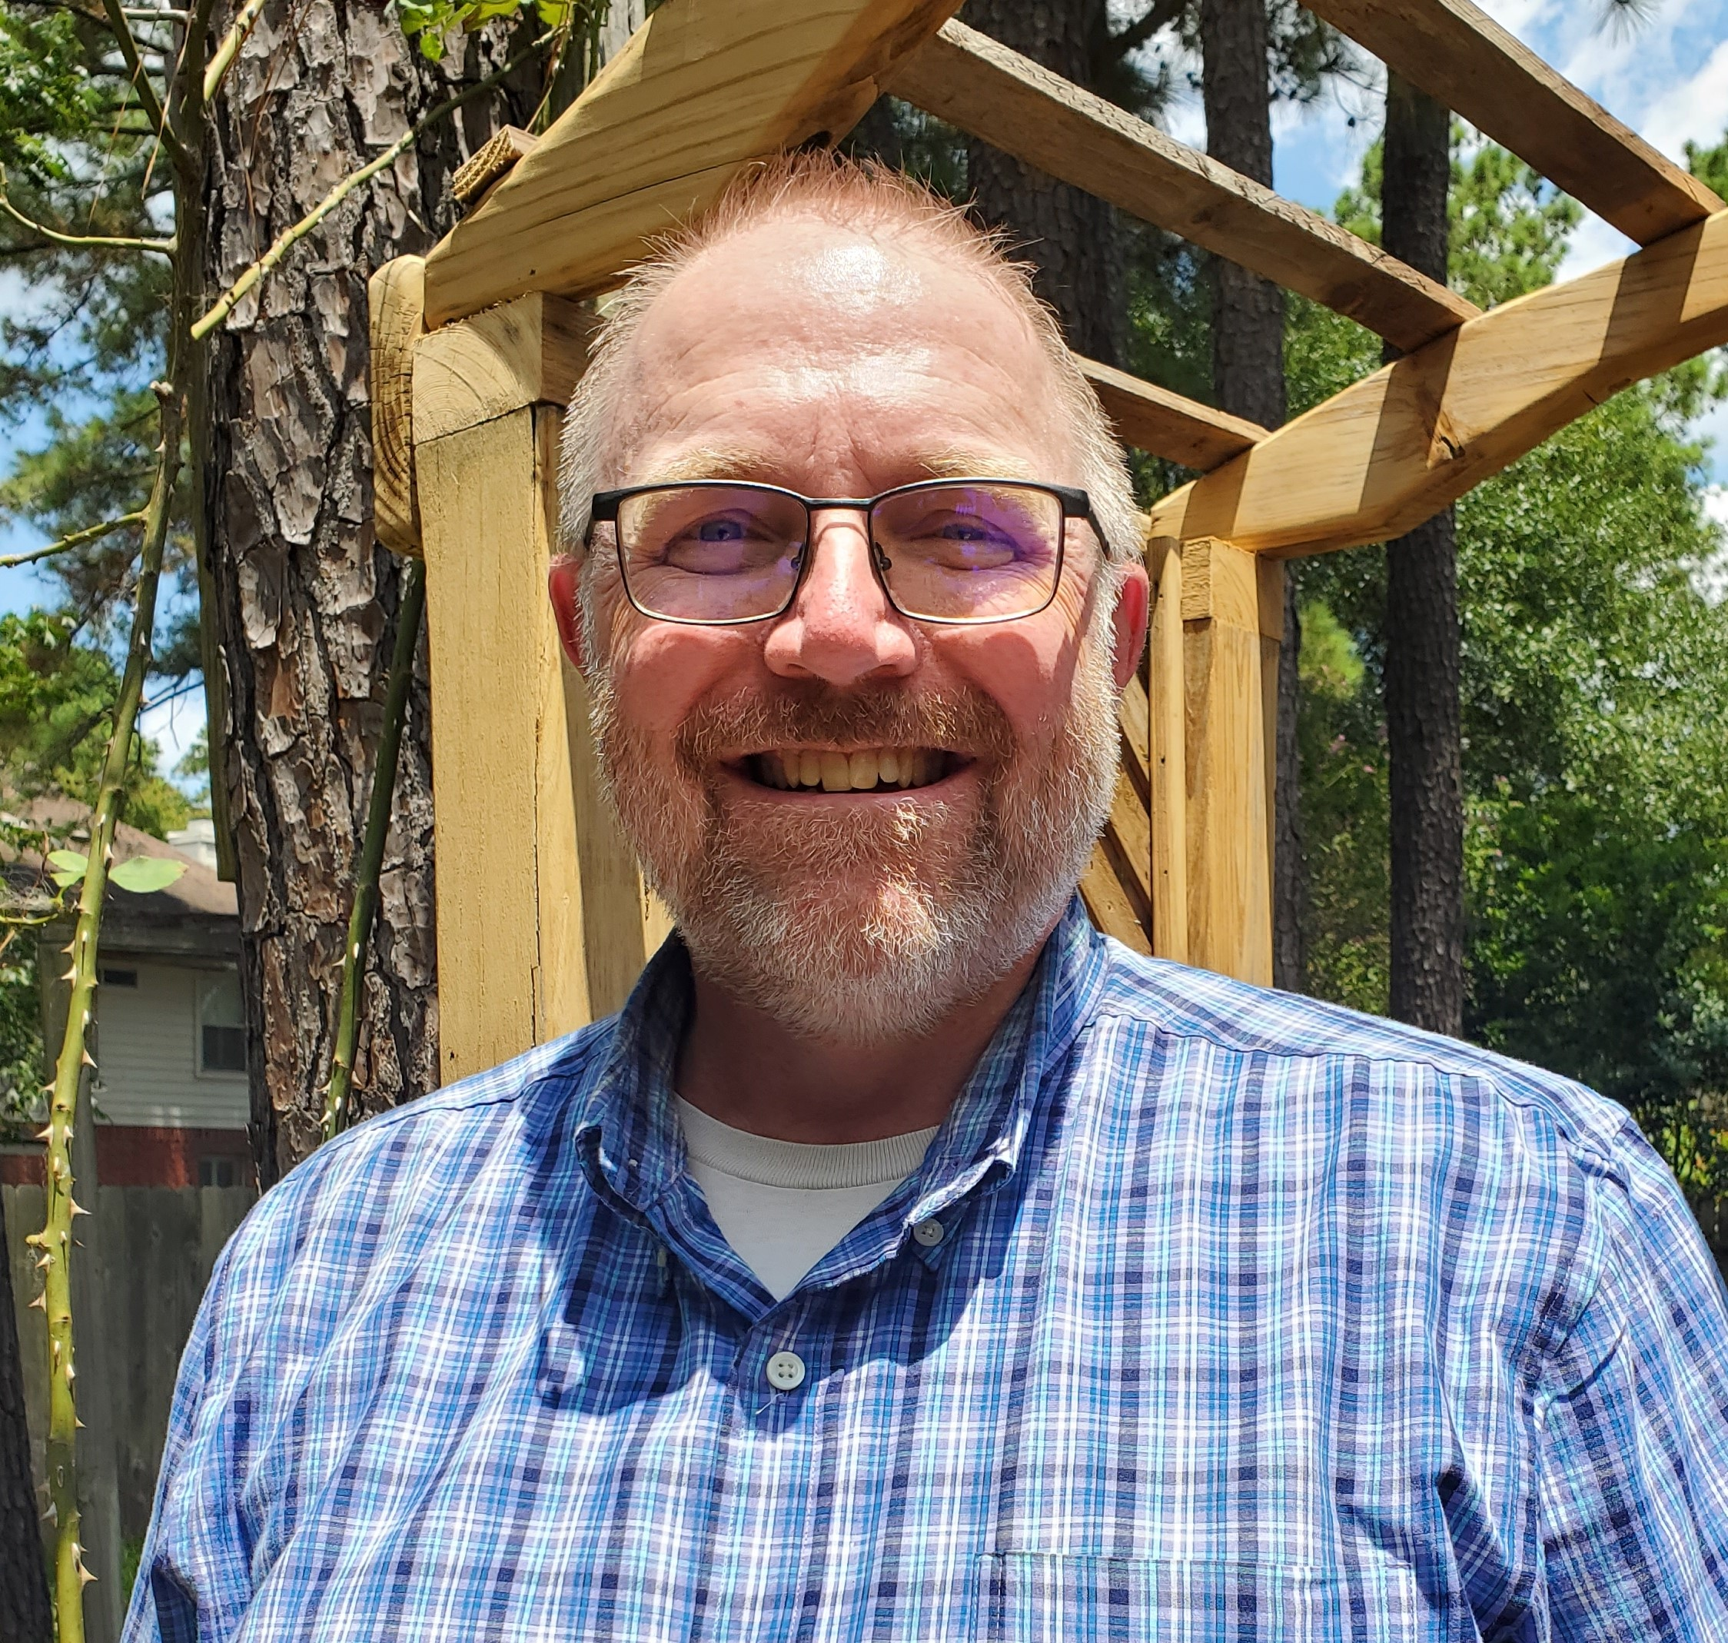
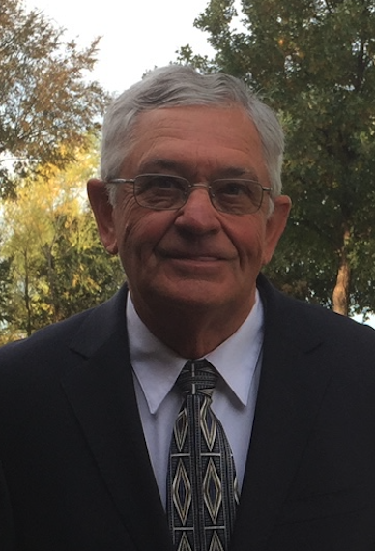
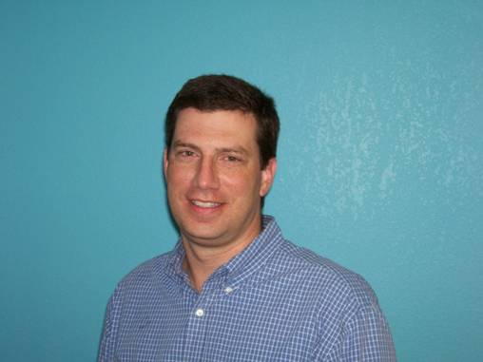
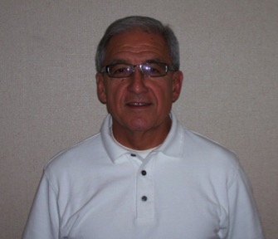
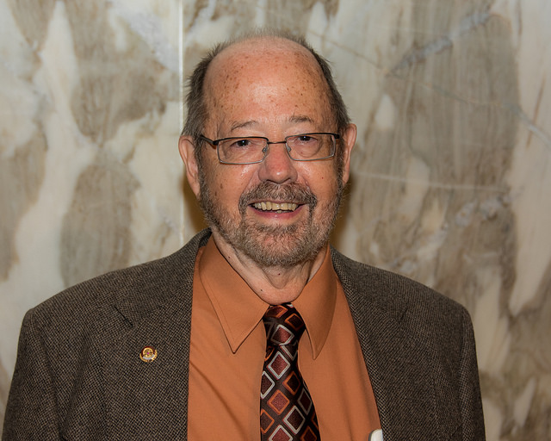
Board 2020
Greg and Jamie Lemon
Gustavo and Micaela Villanueva
Randy King
Paul Gidden
Lewis Norman
Alan Mashburn
Flo Mata
Dick Nill

Slide 4
TIBI’s values
Love
Respect
Open dialogue
Passion to search for truth together and learn
Unity in the heart of the gospel as found in I Cor, 15:1-4, Mat. 22:37-40, Matt. 23:23, Eph. 4:4-6, etc.

Slide 5
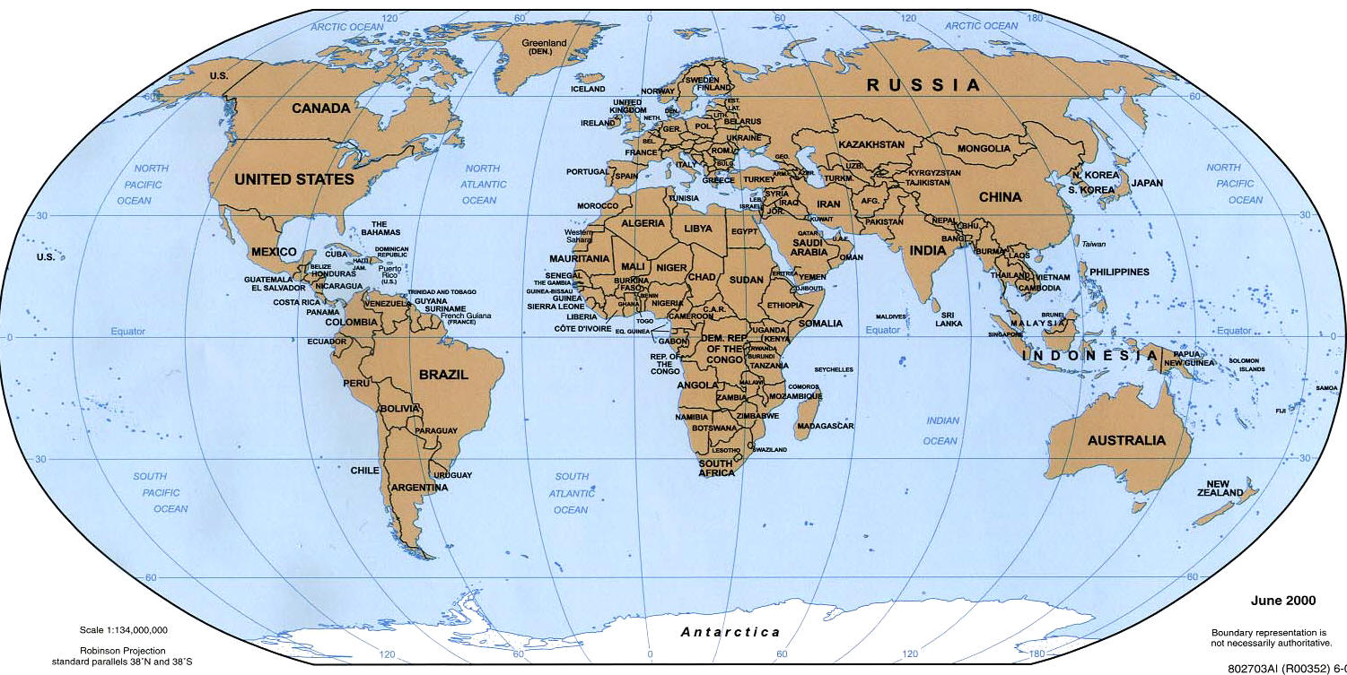
v
v
Valencia, Spain
v
v
v
v
v
v
v
v
v
v
v
v
v
v
v
v
v
v
v
v
v
Countries with video conferencing sites (yellow): 18
Students visited online from 116 countries total
(710 current students, and more than 5000 in all since we began)

Slide 6
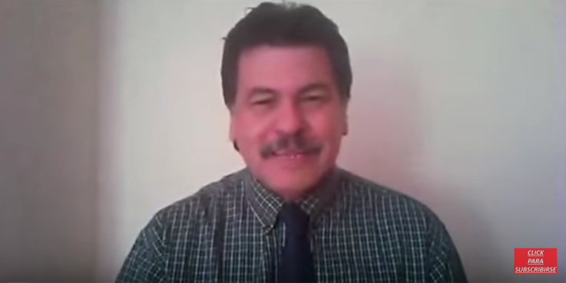
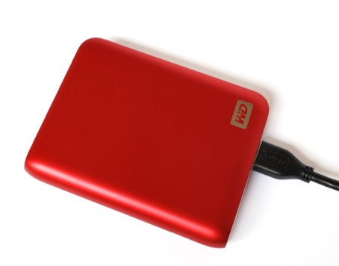
3350+ TIBI students worldwide!
100+ students in intensive,
interactive live video conferencing
classes
700+ online students
2550+ EBL students (hard drive)

Slide 7
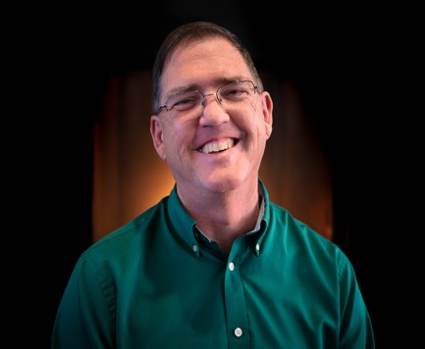
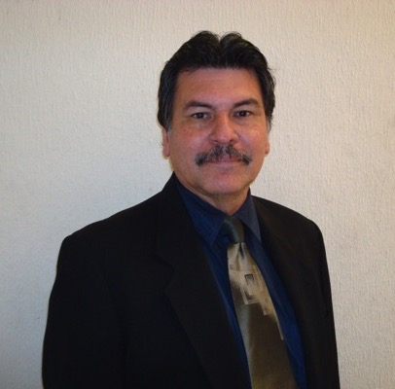
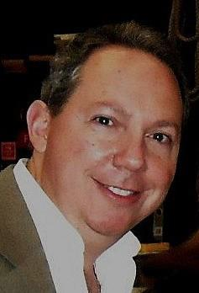
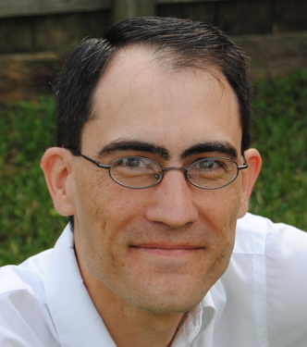
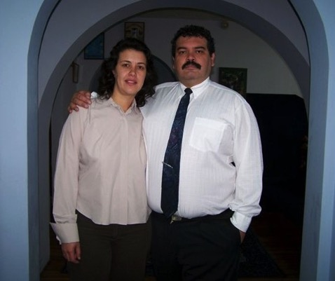
PERSONNEL
Stephen Austin
Director
Carlos Camacho
Field work supervisor
Daniel Urdaneta,
IT specialist
Kevin Montgomery
Assistant director
Pedro and Silvia del Pozo, online program coordinators

Slide 8
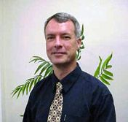
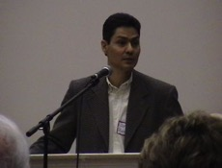
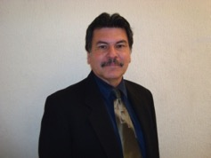
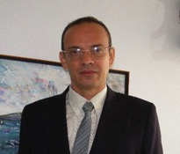
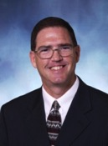
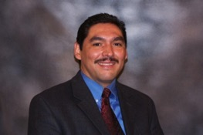
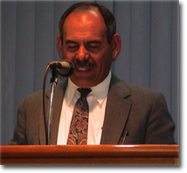
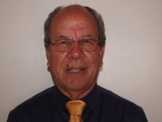
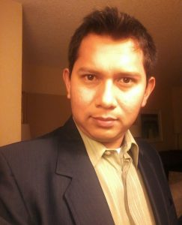
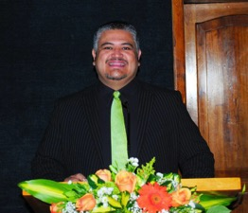
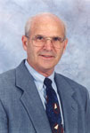
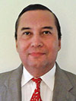
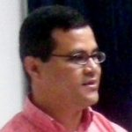
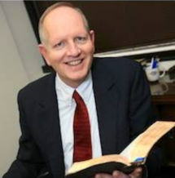
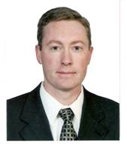
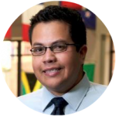
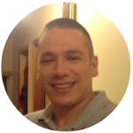
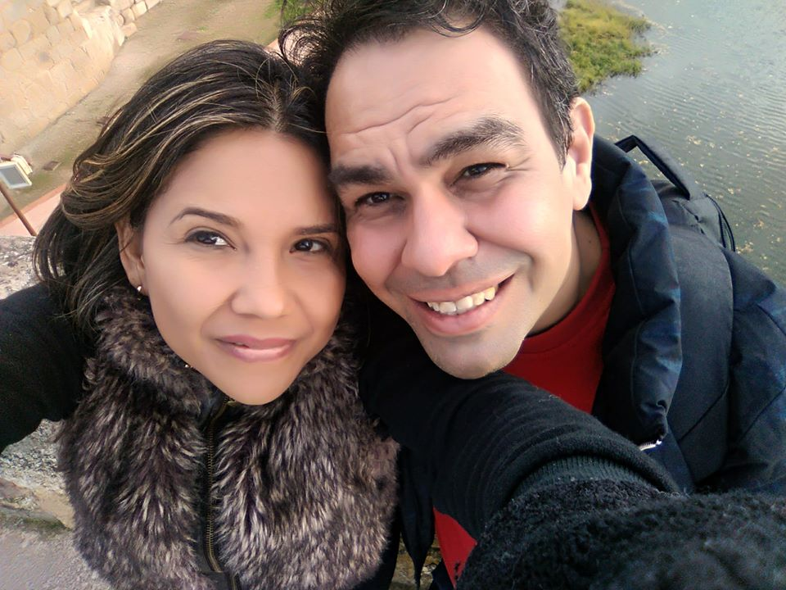
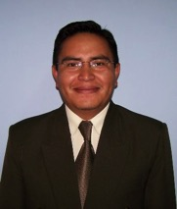
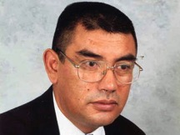
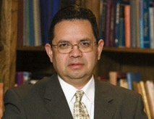
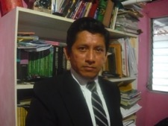
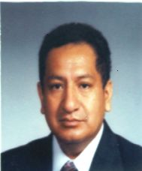
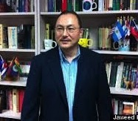
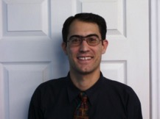
25 teachers, 7 countries
26 teachers,
8 countries!

Slide 9
2020--15th Graduation (final prayer)
Total graduates:
124!

Slide 10
AETH Certification
In August, after a process lasting almost two years, TIBI received word from the Asociación de Estudios Teológicos Hispanos (Association of Hispanic Theological Studies) that they have officially certified our Bachelors Degree, the Licenciatura en el Ministerio y Estudios Bíblicos (Bachelor of Ministry and Biblical Studies).
This certification is extended in collaboration with the Association of Theological School, the main accrediting agency of seminaries in the US.
This is a valuable external endorsement of our program which will allow our graduates to apply for graduate studies at any seminary in the US.

Slide 11
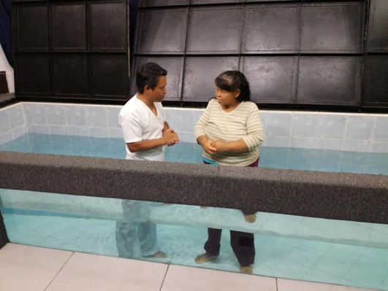
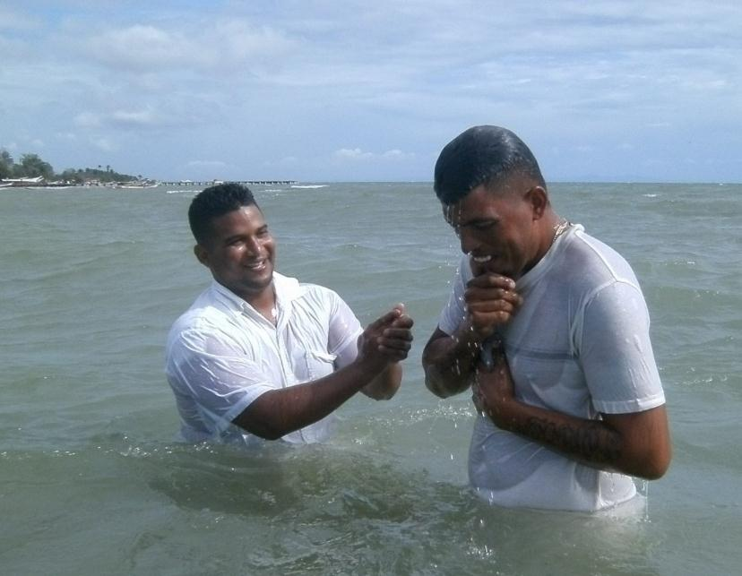
Growing Kingdom Impact Worldwide
We have at least 176 current full-time students or graduates working in 112 congregations in 77 cities in 18 countries (not counting any of our several thousand part-time students)
4450+ baptisms and 63 church plants worldwide since 2009!
(Plus those that weren’t reported!)
July 29, 2020

Slide 12
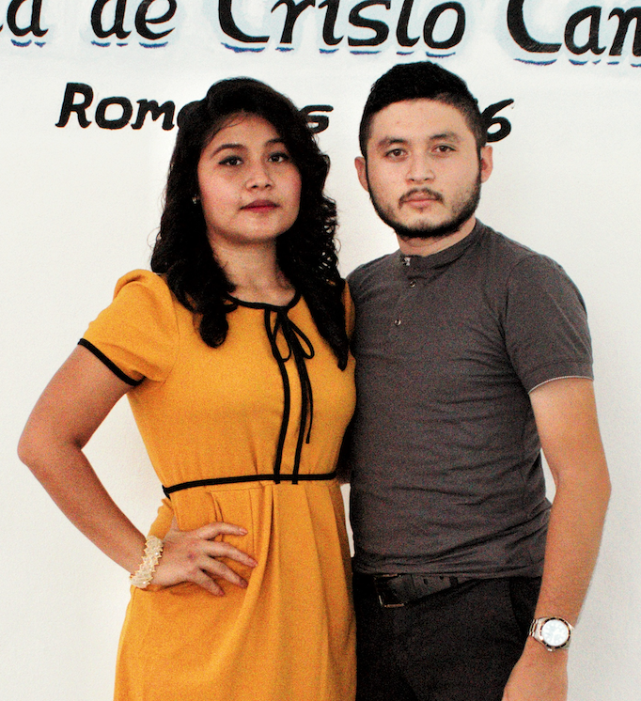
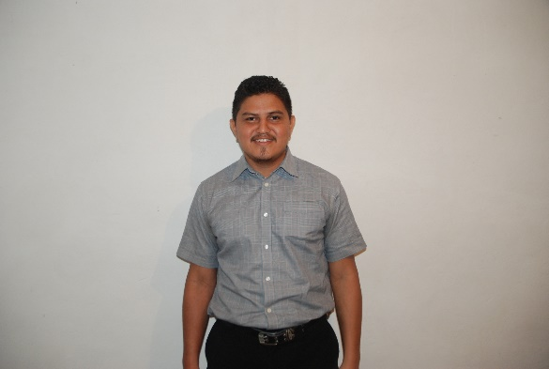
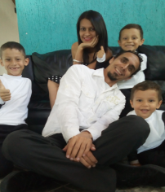
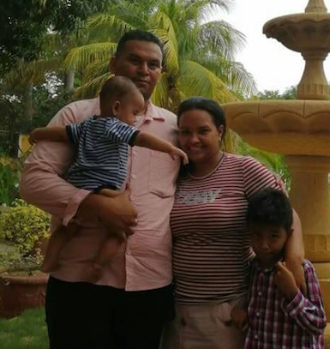
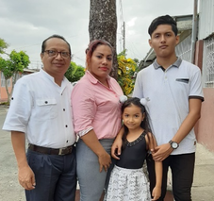
11th TIBI international scholarship full-time class
August, 2020-2022
Abraham Ancona,
And wife Thanis, Mexico
Leonardo Balladares
Nicaragua
Leonardo Capodicasa, wife Dayana, family
Venezuela
Reiner Hernandez, Adriana,
Family, Colombia
Bismarck Castaneda, wife Tania, family, Nicaragua

Slide 13
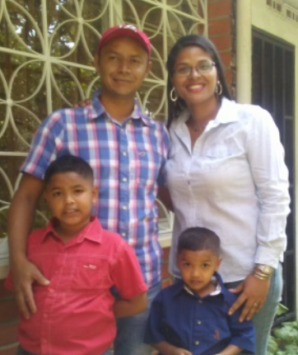
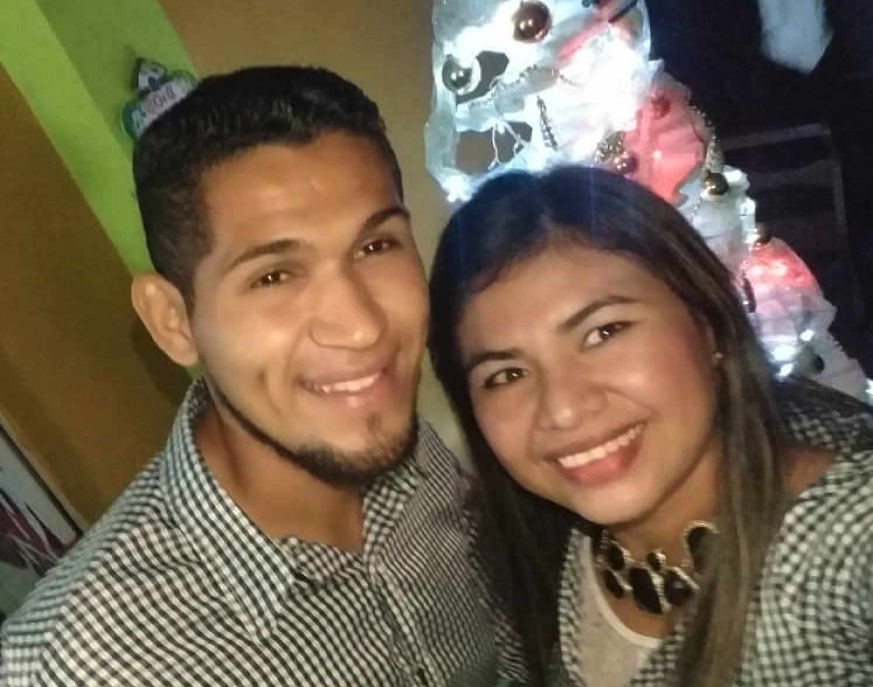
Yheison Parada, Grecia
Venezuela
Juan Montaño
Colombia
Estefani Sanchez, husband Marco,
family, Bolivia
Elizabeth Tabares, husband Yamil, family, Colombia
Alejandro Mena,
wife Jennifer, Nicaragua

Slide 14
ACTIVITIES
Minimum 10 hours/week, supervised, in church planting and ministry

Slide 15
Representatives of 35 church plants in Cuba

Slide 16
La Puerta—Agustin Garcia

Slide 17
Matanzas, Cuba
Planted 50 congregations since 2006!

Slide 18
VIDEO-
CONFERENCING

Slide 20
Up to 25 sites onscreen!
Public/private chat

Slide 21
Interactive screen sharing of all kinds

Slide 22
Advantages
Up to 25 sites on the screen at once!
The TIBI system has capacity for 10800 sites concurrently (300 sites in each of 36 classrooms)
Easy to connect and use
Accessible from any place in world with Internet (even a park in Cuba!)
Inexpensive, easily expandable, all virtual, continuously upgraded

Slide 23
Other options/advantages
Recording to the Cloud or personal computer
Ability to share whiteboard interactively
Ability to share any document and illustrate it
Ability to share videos
Ability to break out groups within classroom
Ability to stream live to Facebook or YouTube
Multiple methods of student feedback
Excellent administrative control and stats

Slide 24
What is needed for Zoom?
Computer with at least average processor speed and RAM
Webcam
Microphone (often included in webcam)
Connection to the internet with speeds at least 384k upload and 1 Mb download.
Zoom software (free)
Small annual network access fee

Slide 25
Video library in the cloud

Slide 26
KINGDOM ACTIVITIES
With video conferencing

Slide 27
Normal live interactive classes (students, churches)
50+ courses offered in 2019-2020 school year
25 hours per week
Saturday seminars

Slide 28
Other current, past, or future activities
One-day seminars or retreats
Masters’ level courses
Ongoing mentoring by other missionaries, elders, ministers, or professionals
Mission team training
Individual or marriage counseling
Classes for refugees
Marriage ceremonies or baptisms!

Slide 29
ONLINE
PROGRAM

Slide 30
www.ibitenlinea.org
In preparation
Proverbs—The Godly Woman
Church planting, Cuba
Available now—40 courses
Old Testament New Testament Tools Ministry
OT 1, 2, 3, 4 Life of Christ 1, 2 Hebrew 1 , 2 Spiritual Formation
Wisdom literature Acts Greek 1, 2 Christian Home
Isaiah Romans/Galatians Hermen./Exeg. 1, 2 Counseling
Jeremiah/Lamentations 1-2 Corinthians Homiletics Leadership
Ezekiel/Daniel Prison epistles Analytical thinking Christianity/Culture
Minor prophets Pastorals Intro to Ministry
1-2 Peter, James History Small groups
Hebrews History/Geography Religious groups
Revelation Church History 1 Church planting
Restoration History Worship
Heaven

Slide 31
Online video courses
With 40 courses recorded, one can now study online and receive the Bachelor of Biblical Studies diploma.
710+ students in 68 countries—including 20 of the 21 Spanish speaking countries as well as other nations like Brazil, France, Germany, and Canada!

Slide 32
Benefits
Requires only an internet connection
Classes are available 24 hours a day
Can take the courses for free

Slide 33
Hard Drives for Remote Schools
For remote locations where there is limited to no access to the internet, we put all our course materials on hard drives
Facilitated and graded by local workers
Currently 28 such drives have been sent to 12 different countries.
In Cuba, for example, TIBI
has more than 15,500 students
who have used this format.

Slide 34
TIBI is now on YouTube
https://www.youtube.com/c/InstitutoBiblicoInternacionaldeTexasIBIT
Or
search “IBIT Instituto”
on the YouTube page

Slide 35
TIBI Playlist page

Slide 36
SINCE APRIL 2015 ON YOUTUBE…
900+ videos uploaded
1,025,000+ views
More than 7.1 million minutes viewed
10,500+ subscribers
Easier access for some in Internet-limited places

Slide 37
TIBI website
(ibitibi.org)

Slide 38
Master of Practical Theology
In conjunction with other schools such as the Quito School of Biblical Studies, in the fall of 2018 we began to offer this new 36-hour masters degree, to better prepare ministers for working in the local congregations.
A total of 39 students comprise the first three cohorts in the program, with the first cohort scheduled to graduate in 2021.
If you would like more information, go to the website at www.redinbi.org

Slide 39
New opportunity in the Mediterranean Rim
Thousands of Muslim converts
TIBI has begun to help train them in basic Christianity
People like Farshad Shirazi are key, as well as a new course we tailored to them, in Farsi.
Austrian students,
with Steve Austin

Slide 40
FABULOUS STORIES OF HOW GOD WORKS…
In the prisons in Cuauhtémoc, Mexico with Othoniel Gutierrez.
In gang neighborhoods, in national crisis, through Isaac Torres in Venezuela.
In Cuba through Tony and Liudmila Fernandez.
Who know what else God has in store?

Slide 41
With God’s power and creativity, we are like:
Gideon, whose weakness God changed to strength.
Esther, whom God used in the right place at the right time.
Mustard plants, which grow large from a tiny seed.

Slide 42
How can you help?
Encouragement and prayer.
Come visit! And tell others…
Recommend students
Contribute to a student scholarship ($100-700/month)
Buy hard drive for remote sites ($70)

Slide 43
Ways to Donate
Download the Zelle app on your phone or tablet, and send money to montgomery.texasbible@gmail.com
Online bill pay with your bank (can set it up to be recurring)
Paypal: Go to http://ibitibi.org/en/donations, click on Donate, and put in our info (can be recurring)
Normal checks
Even estate gifts or IRA disbursements.

Slide 44
TIBI Information and Resources
School Website: www.ibitibi.org
Masters program: www.redinbi.org
Online video courses: ibitenlinea.org
YouTube (courses and Israel videos) https://www.youtube.com/c/InstitutoBiblicoInternacionaldeTexasIBIT
Facebook https://www.facebook.com/IBIT-y-Sunsetonline-111879462197567/?fref=ts
Twitter https://twitter.com/IBITcursos

Slide 45
Texas International Bible Institute
STEPHEN AUSTIN
slaustin@cebridge.net
KEVIN MONTGOMERY
montgomery.texasbible@gmail.com
1502 Avenue I
Or P.O. Box 1501
South Houston, Texas, 77587
(713) 910-2819

